Slide 1
QSAR Application Toolbox
Workflow
Laboratory of Mathematical Chemistry,
Bourgas University “Prof. Assen Zlatarov”
Bulgaria

Slide 2
Outlook
Description
General scheme and workflow
Basic functionalities
Forming categories

Slide 3
Philosophy
Toolbox helps registrants and authorities to
Use the methodologies to group chemicals into categories and
Refine and expand the categories approach
Provide a mechanistic transparency of the formed categories
Fill data gaps by read-across, trend analysis and (Q)SARs
Ensure uniform application of read-across
Support the regulatory use of (Q)SAR approach
Improve the regulatory acceptance of (Q)SAR methods

Slide 4
Philosophy
(Q)SAR Toolbox is a central tool for non-test data in ECHA and OECD
ECHA and OECD coordinate the Toolbox development

Slide 5
Description
Toolbox is not a QSAR model and hence can not be compared with other QSAR models
Training sets (categories) for each prediction are defined dynamically as compared to other (Q)SAR model which have rigid training sets
Each estimated value can be individually justified based on:
Category hypothesis (justification) and consistency
Quality of measured data and
Computational method used for grouping and data gap filling

Slide 6
Description
It is developed under the continuing peer review of:
Member state countries,
Regulatory agencies
Chemical industry and NGOs
The predictions are getting acceptance by toxicologists and regulators due to the:
International peer review process for developing the system and
Mechanistic transparency of the results
The system is freely available and maintained in the public domain by OECD

Slide 7
History
Phase I - The first version (2005 - 2008)
Emphasizes technological proof-of-concept
Released in 2008
Developed by LMC
Phase II (2008 - 2012)
More comprehensive Toolbox which fully implements the capabilities of the first version
Second version released in 2010
Developed by LMC, subcontractors: LJMU, Lhasa Ltd and TNO
Third version released in 2012
Maintenance 2013 - v. 3.2 in January 2014
Version 3.3.1 - released in December 2014
Version 3.3.2 - released in February 2015
Version 3.3.5 - released in June 30, 2015
Version 3.4 - released in July, 2016

Slide 8
History
Phase III (2014 – 2019 + 4 years maintenance)
Toolbox v.4.0
Significant focus on streamlining
Building automated and standardized workflows for selected endpoints
Migrating to a new IT platform
Knowledge and data rationalization and curation
Implementation of Ontology
Implementation of knowledge and data on ADME
Implementation of AOPs
Developed by LMC, subcontractors: LJMU and Lhasa Ltd

Slide 9
Main Government Donators
OECD
European chemicals agency
US EPA
Environment Canada
Health Canada
NITE Japan
NIES Japan
Danish EPA
UBA Germany
NICNAS Australia
DEWNA Australia
ISS Italy
Notes:
9

Slide 10
Main Industry Donators
L’Oreal
DuPont
Givaudan
Dow chemicals
BASF
ExxonMobil
3M
Firmenich SV
SRC, Syracuse
Unilever
Procter & Gamble
Notes:
10

Slide 11
Download statistic
Downloads (version 2.1):
1496 downloads of standalone version (July 15, 2011)
171 downloads of server based version (July 15, 2011)
Downloads (version 2.2):
2051 downloads of standalone version (July 15 – Feb. 06, 2012)
424 downloads of server based version (Feb. 06, 2012)
62 automatic updates (Feb. 06, 2012)
Downloads (version 3.x): March 2017
11264: Total number of user accounts
10514: Activated user accounts
10373: Users that have logged in at least once
11251: Distinct IP addresses from which a Toolbox 3 has been downloaded
Notes:
11

Slide 12
Download statistics of QSAR Toolbox 3.x by registered users worldwide
(March 2017)

Slide 13
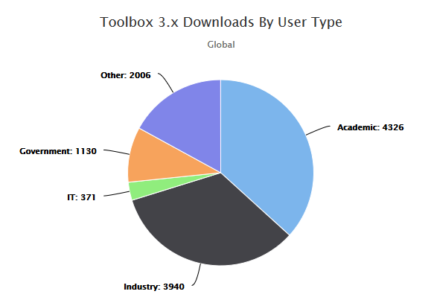
Download statistics of QSAR Toolbox 3.x by registered users worldwide
(March 2017)

Slide 14
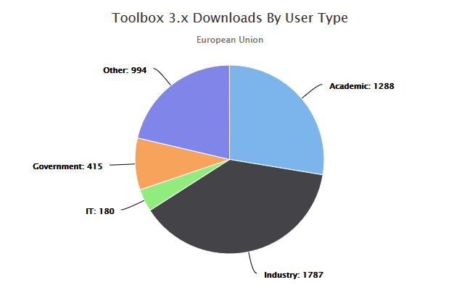
Download statistics of QSAR Toolbox 3.x by registered users worldwide
(March 2017)

Slide 15
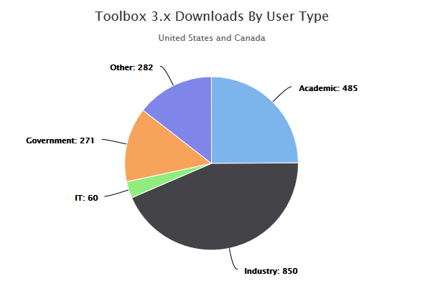
Download statistics of QSAR Toolbox 3.x by registered users worldwide
(March 2017)

Slide 16
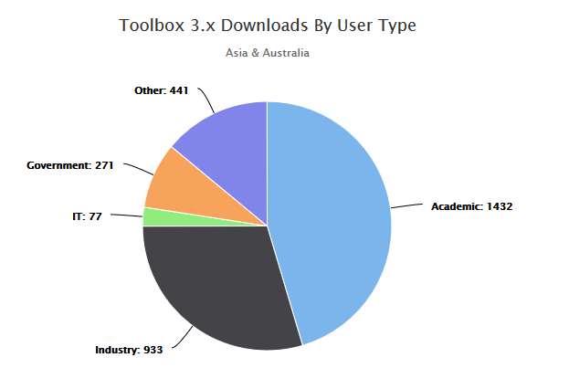
Download statistics of QSAR Toolbox 3.x by registered users worldwide
(March 2017)

Slide 17
QSAR and read-across based submissions to the ECHA
For existing substances at or above 1000 tpa*
(2011 ECHA report)
ENV = environmental endpoint; HH = human health endpoint
*H. Spielmann et al. ATLA 39, 481–493, 2011

Slide 18
Outlook
Description
General scheme and workflow
Basic functionalities
Forming categories
Notes:
18

Slide 19
General Scheme
Theoretical knowledge
Empiric knowledge
Computational methods
Information technologies.
Notes:
19

Slide 20
Input

Slide 21
Input
Is the chemical included in regulatory or chemical categories?
Could this chemical interact with DNA or specific proteins?
Could this chemical cause adverse effects?
Is the effect due to parent chemical or its metabolites?
Knowledge

Slide 22
Input
Knowledge
Experimental
Data
Are data available for assessed endpoints of target chemical?
Is information for the data sources available?

Slide 23
Input
Knowledge
Experimental
Data
Search for possible analogues using existing categorization schemes
Group chemicals based on common chemical/toxicological mechanisms and/or metabolism
Design a data matrix of a chemical category
Set the endpoints hierarchy in the data matrix
Categorization
tools

Slide 24
Input
Knowledge
Experimental
Data
Read-across
Trend Analysis
(Q)SAR
Data gap
filling
tools
Categorization
tools

Slide 25
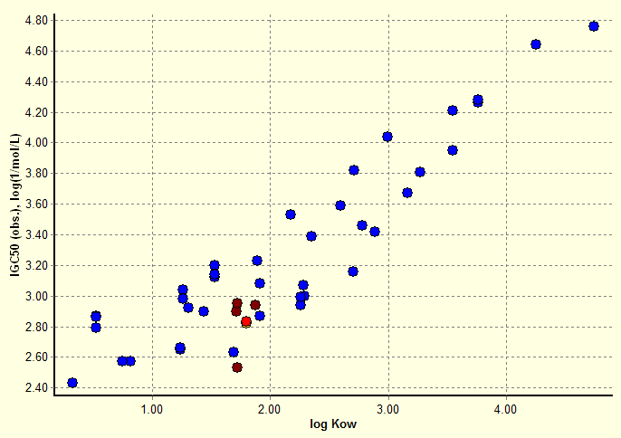
Input
Knowledge
Experimental
Data
Read-across
Trend Analysis
(Q)SAR
Data gap
filling
tools
Categorization
tools

Slide 26
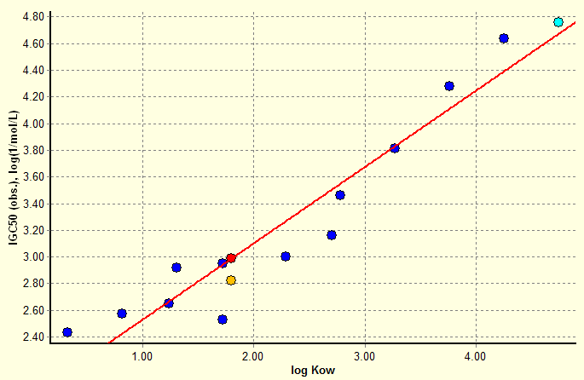
Input
Knowledge
Experimental
Data
Read-across
Trend Analysis
(Q)SAR
Data gap
filling
tools
Categorization
tools

Slide 27
Input
Knowledge
Experimental
Data
Data gap
filling
tools
Reporting tools
Categorization
tools

Slide 28
Input
IUCLID 6 interface: Web Services
Submission of in silico predictions from Toolbox to IUCLID 6
Knowledge
Experimental
Data
IUCLID6
Data gap
filling
tools
Reporting tools
Categorization
tools

Slide 29
Input
IUCLID 6 interface: Web Services
Transfer of data from IUCLID 6 to Toolbox
Knowledge
Experimental
Data
IUCLID6
Data gap
filling
tools
Reporting tools
Categorization
tools

Slide 30
Input
CATALOG interface: by XML (*.i6z)
Transfer of data from CATALOG to Toolbox
Knowledge
Experimental
Data
IUCLID6
Data gap
filling
tools
Reporting tools
Categorization
tools

Slide 31
System Workflow
IUCLID6
Chemical
input
Profiling
Endpoints
Category
Definition
Filling
data gap
Report
Data gap
filling
tools
Reporting tools
Knowledge
Base
Data
Base
Categorization
tools

Slide 32
Toolbox interactions
Canadian
POPS
IUCLID6
GHS
Standardized prediction report
Catalogic
Reactivity
prioritization
IATAs
TIMES
TOOLBOX
HH
prioritization
Pipeline profilers
Other models
PBT
prioritization
Docked software provides additional tools: calculators; (Q)SAR models;
metabolism simulators …
Toolbox provides results for a target chemical: measured values; (Q)SAR or Read-across predictions

Slide 33
Outlook
Description
General scheme and workflow
Basic functionalities
Forming categories
Notes:
33

Slide 34
Basic functionalities
Input
Structure - QA
Endpoint definition
Query tool (separate presentation – see “QSAR_Toolbox_4_Customized search_QT.ppt”)
Profiling
Relevancy of profilers
SMARTS implementation
Profiling groups
Data
Relevancy of databases
Data groups and documentation
Reliability scores of databases
Import/Export (separate presentation – see “QSAR_Toolbox_4_Import_Export data.ppt”)
Category definition
Alert performance – with and without accounting metabolism
Grouping with accounting for metabolism
Identification of activated metabolite representing target chemical
Data Gap Filling
Principle approaches for DGF
Automated and standardized workflows (separate presentation – see “QSAR_Toolbox_4_Workflows_for_Ecotox_and_Skin_ sens.pptx”)
Subcategorization
Endpoint vs. endpoint
Report
Data matrix
Notes:
34

Slide 35
Basic functionalities
Input
Structure - QA
Endpoint definition
Query tool (separate presentation – see “QSAR_Toolbox_4_Customized search_QT.ppt”)
Profiling
Relevancy of profilers
SMARTS implementation
Profiling groups
Data
Relevancy of databases
Data groups and documentation
Reliability scores of databases
Import/Export (separate presentation – see “QSAR_Toolbox_4_Import_Export data.ppt”)
Category definition
Alert performance – with and without accounting metabolism
Grouping with accounting for metabolism
Identification of activated metabolite representing target chemical
Data Gap Filling
Principle approaches for DGF
Automated and standardized workflows (separate presentation – see “QSAR_Toolbox_4_Workflows_for_Ecotox_and_Skin_ sens.pptx”)
Subcategorization
Endpoint vs. endpoint
Report
Data matrix
Notes:
35

Slide 36
Input
Chemical can be loaded in Toolbox by:
CAS #
Name
SMILES
Selection from a list, database or inventory
The chemical identification related to the correspondence between substance identity and associated data in Toolbox, currently is based on:
CAS #
SMILES
Predefined substance type
Composition:
Constituents
Additives
Impurities
Notes:
36

Slide 37
Input Structure
Expanded chemical structure
CAS 50000
Notes:
37

Slide 38
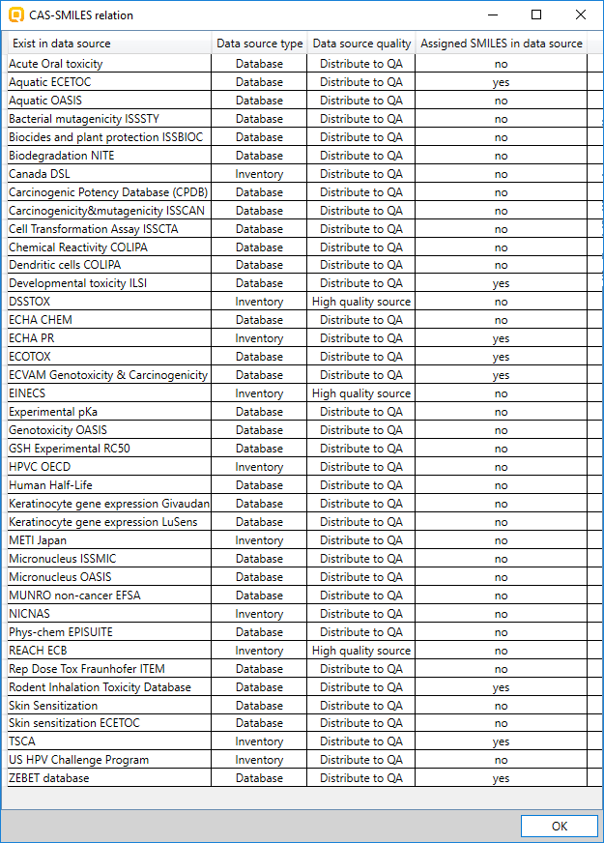
Input Structure
Expanded chemical structure
Explain of QA label
CAS 50000
CAS-Smiles relation
Notes:
38

Slide 39
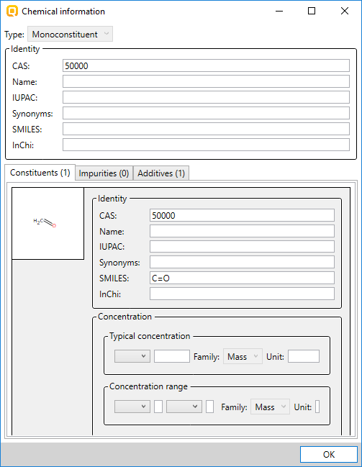
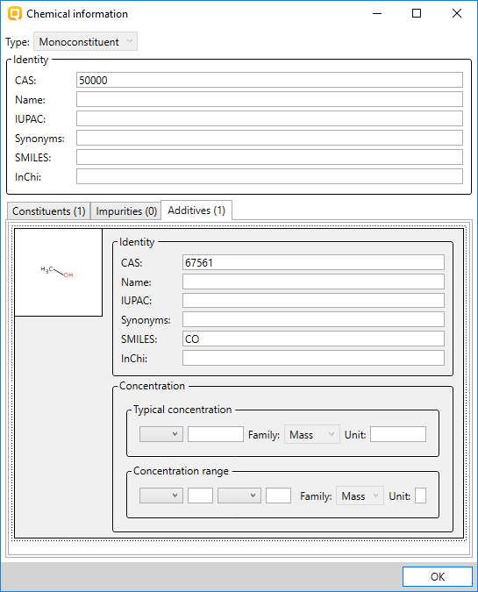
Input Structure
Expanded chemical structure
Explain of Composition structure
CAS 50000
Information for the composition:
C: Constituent
A: Additive
I: Impurity
Constituent
Additive
Concentration filed
Notes:
39

Slide 40
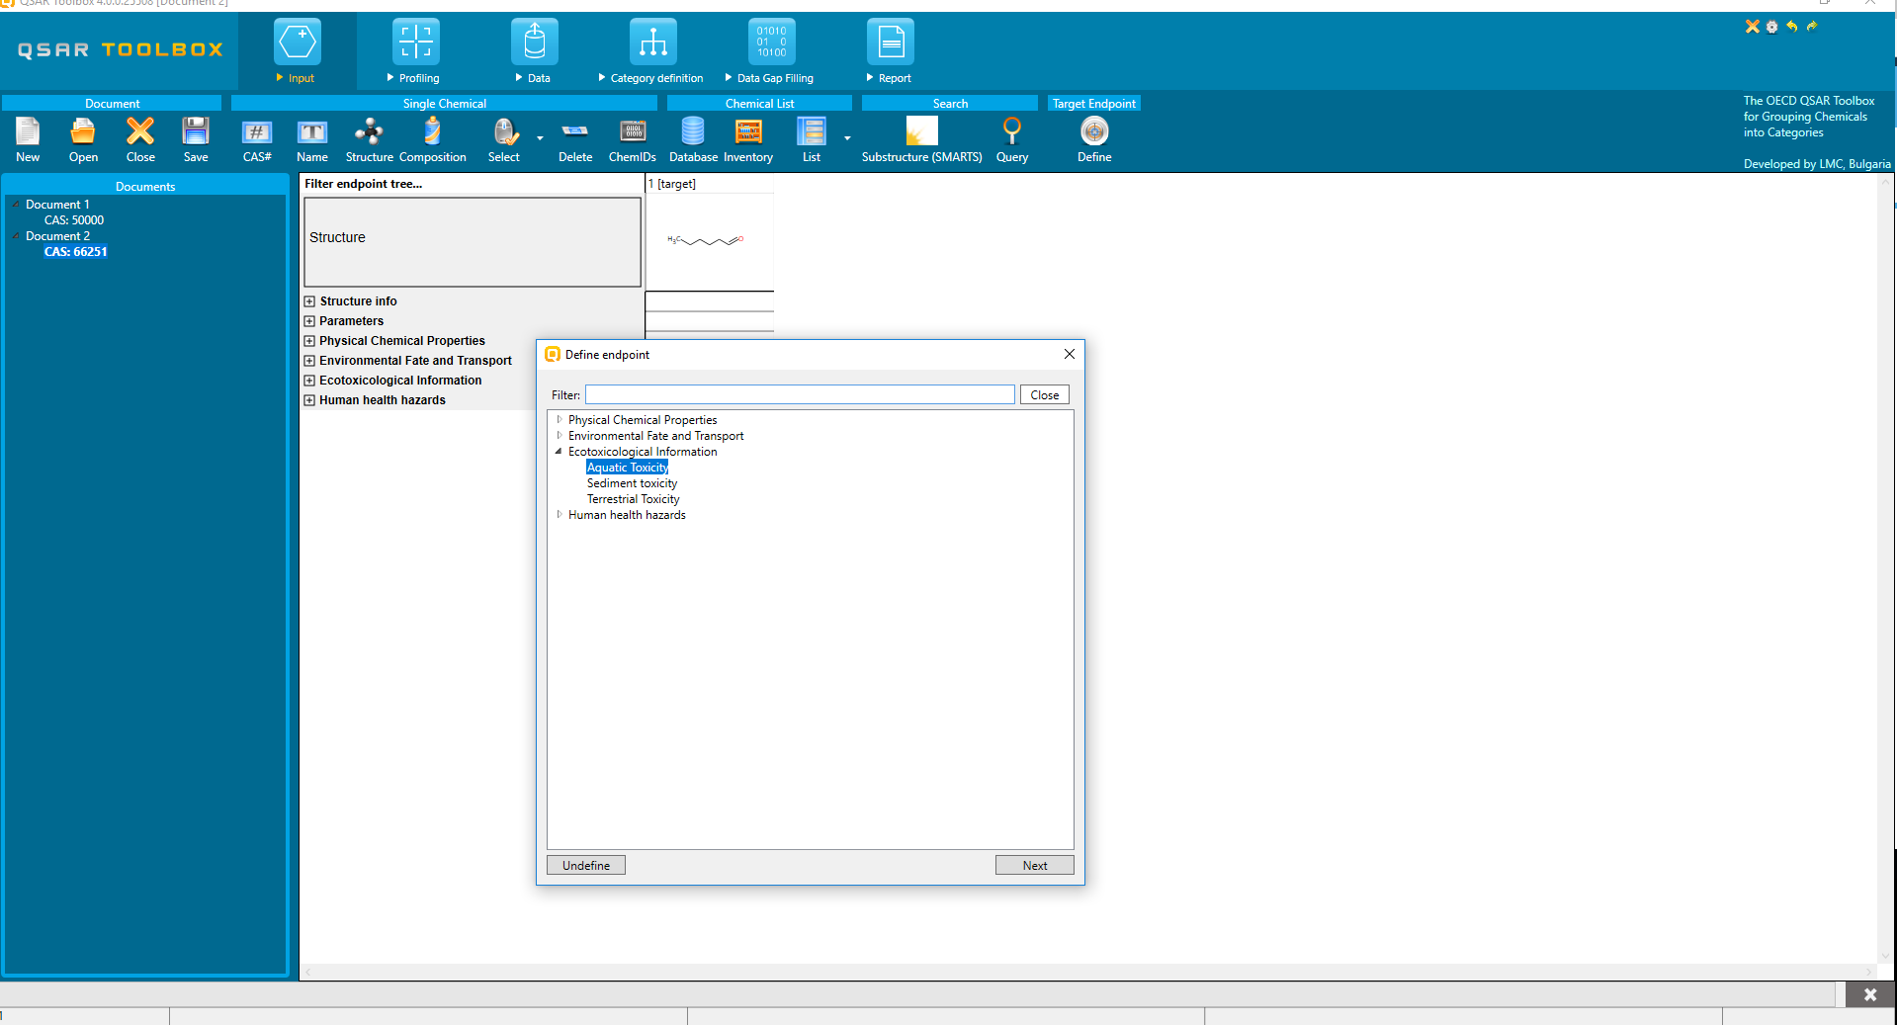
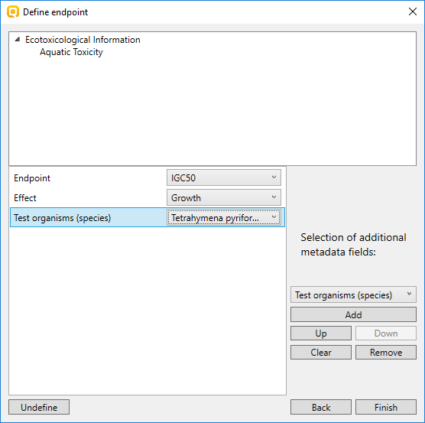
Input Endpoint
CAS 66251
Target endpoint is: Aquatic toxicity
Endpoint: IGC50
Effect: Growth
Test, organism (species): Tetrahymena pyriformis
Selection of main toxicological level
Selection of additional meta data fields
Notes:
40

Slide 41
Input Endpoint
Query Tool (QT)
Provides possibility to search for chemicals by preliminary defined criteria
Chemicals could be searched by:
specific structural fragments
parametric calculations
experimental data
specific profiling category
combinations of all above
Chemicals will be searched in preliminary selected databases
Notes:
41

Slide 42
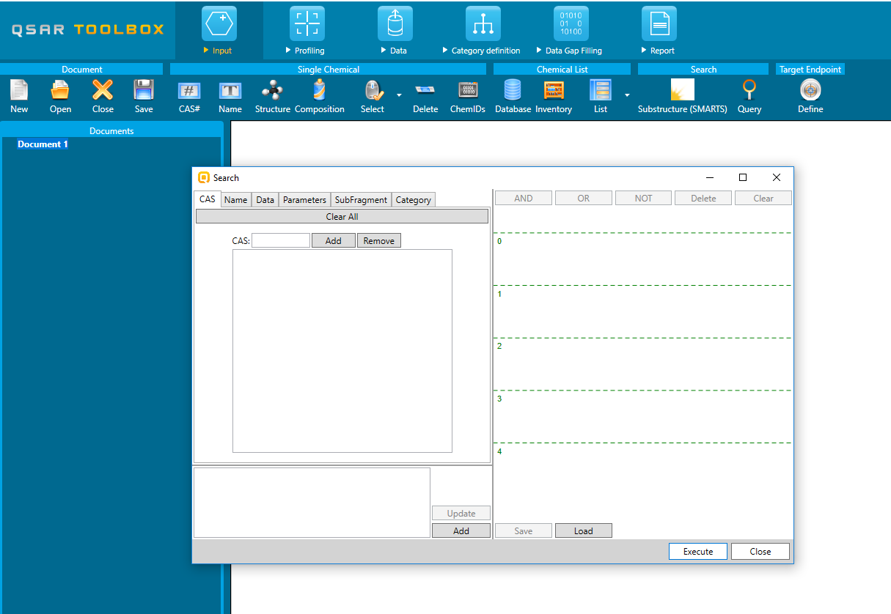
Input Endpoint
Query Tool (QT)
Notes:
42

Slide 43
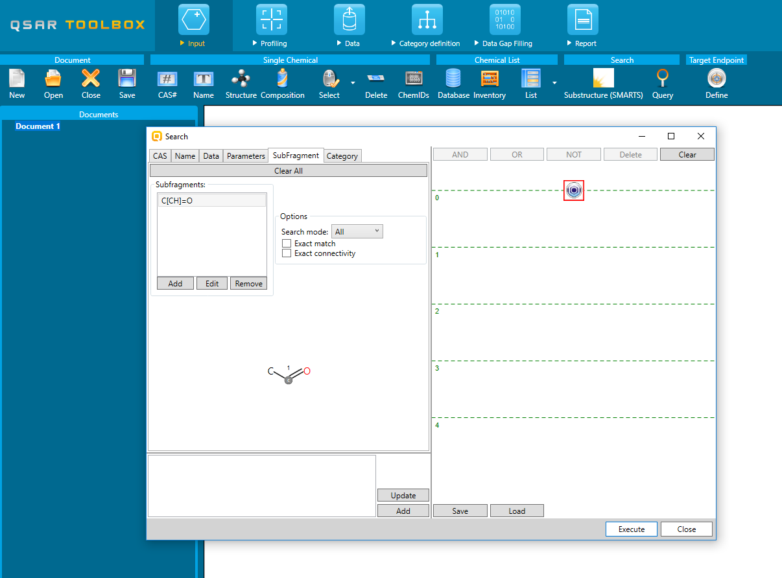
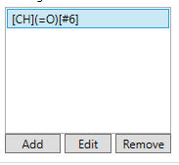
Input Endpoint
Example: Search for chemicals which are Aldehydes and have LC50 ≤ 1 mg/l (Mortality, 96h, Pimephales Promelas)
Query Tool (QT)
Defining structural fragment for aldehyde
Aldehyde subfragment
Notes:
43

Slide 44
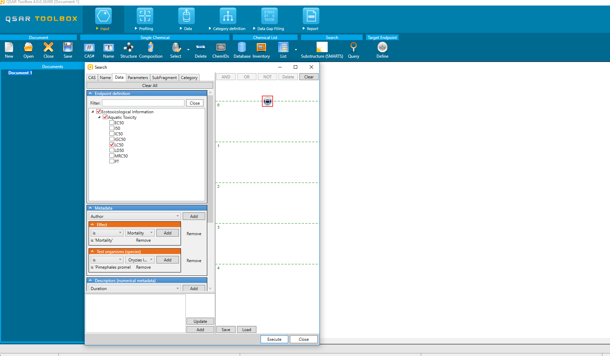
Input Endpoint
Example: Search for chemicals which are Aldehydes and have LC50 ≤ 1 mg/l (Mortality, 96h, Pimephales Promelas)
Query Tool (QT)
Defining toxicity criteria
Endpoint
Effect
Organism
Notes:
44

Slide 45
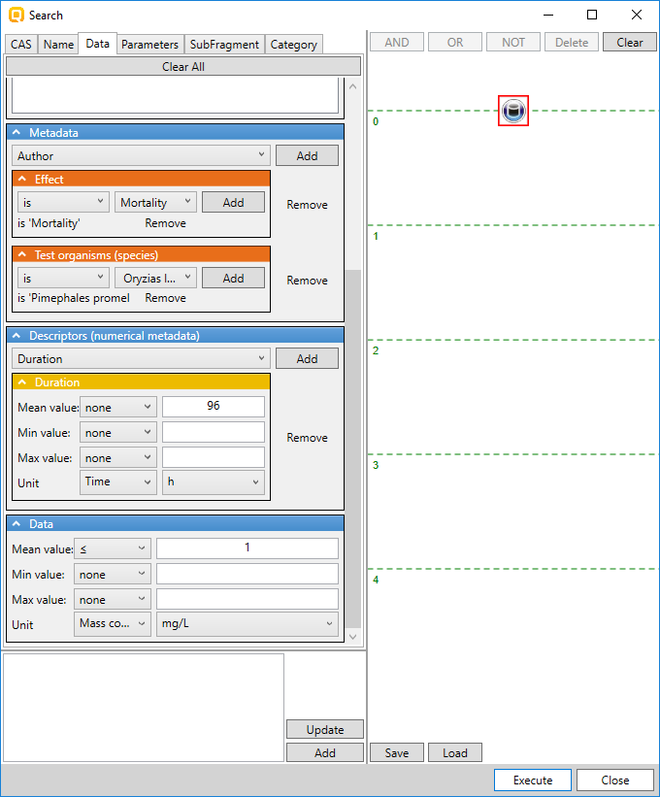
Input Endpoint
Example: Search for chemicals which are Aldehydes and have LC50 ≤ 1 mg/l (Mortality, 96h, Pimephales Promelas)
Query Tool (QT)
Defining toxicity criteria
Duration
Criteria for toxicity
Notes:
45

Slide 46
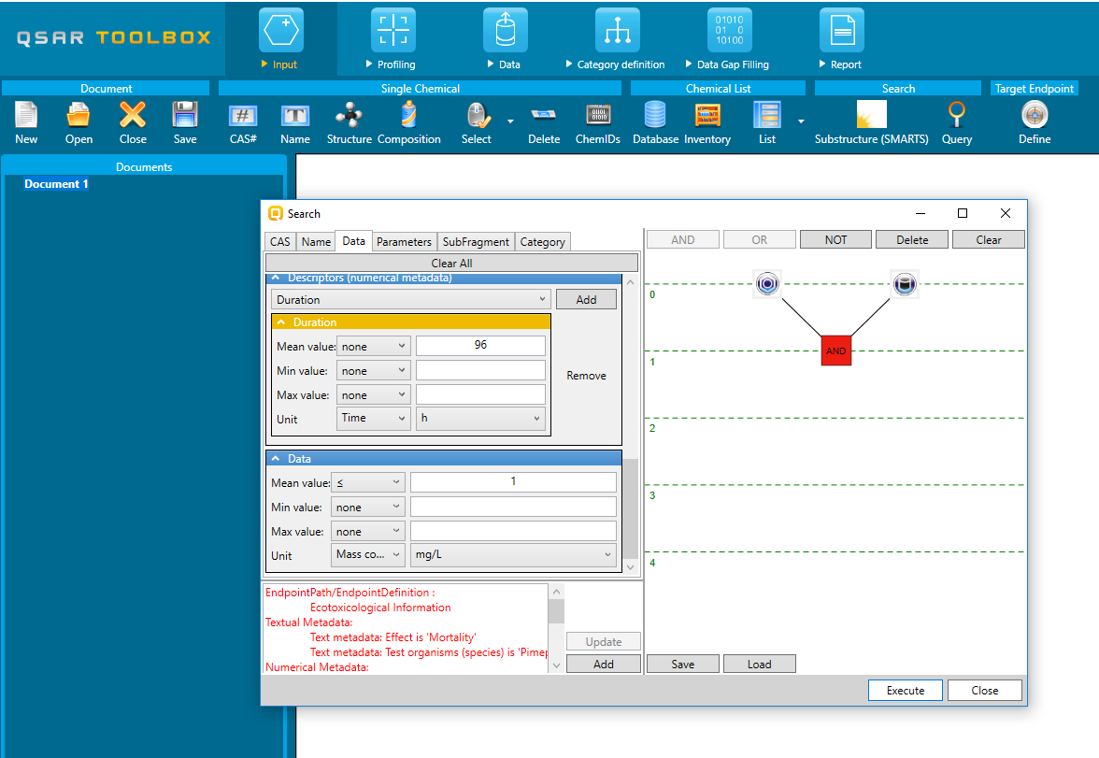
Input Endpoint
Example: Search for chemicals which are Aldehydes and have LC50 ≤ 1 mg/l (Mortality, 96h, Pimephales Promelas)
Query Tool (QT)
Both criteria logically AND-ed
Notes:
46

Slide 47
Input Endpoint
Example: Search for chemicals which are Aldehydes and have LC50 ≤ 1 mg/l (Mortality, 96h, Pimephales Promelas)
Query Tool (QT)
Result after execution of the query: 7 chemicals found
Notes:
47

Slide 48
Basic functionalities
Input
Structure - QA
Endpoint definition
Query tool (separate presentation – see “QSAR_Toolbox_4_Customized search_QT.ppt”)
Profiling
Relevancy of profilers
SMARTS implementation
Profiling groups
Data
Relevancy of databases
Data groups and documentation
Reliability scores of databases
Import/Export (separate presentation – see “QSAR_Toolbox_4_Import_Export data.ppt”)
Category definition
Alert performance – with and without accounting metabolism
Grouping with accounting for metabolism
Identification of activated metabolite representing target chemical
Data Gap Filling
Principle approaches for DGF
Automated and standardized workflows (separate presentation – see “QSAR_Toolbox_4_Workflows_for_Ecotox_and_Skin_ sens.pptx”)
Subcategorization
Endpoint vs. endpoint
Report
Data matrix
Notes:
48

Slide 49
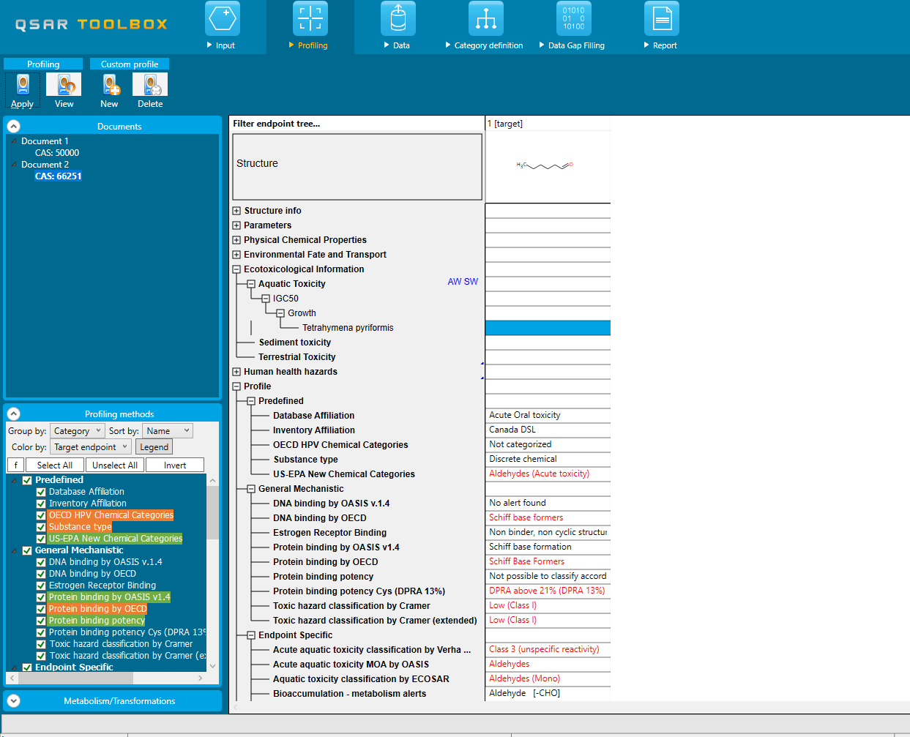
Profiling
Identification of structural features, possible interactions mechanisms with macromolecules, etc. by making use of knowledge base.
Profiling results could be found for target chemicals as well as for simulated/observed metabolites
Notes:
49

Slide 50
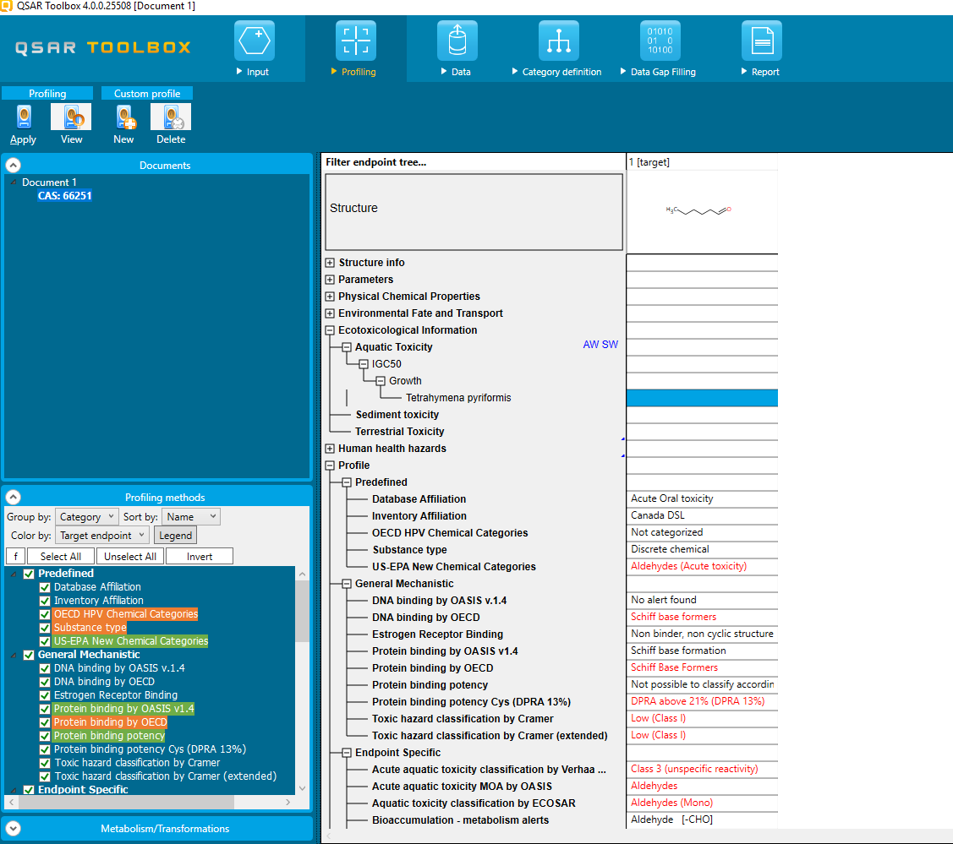
Profiling
Relevancy of profilers
Profiler relevancy with complete definition of the endpoint
Complete endpoint definition

Slide 51
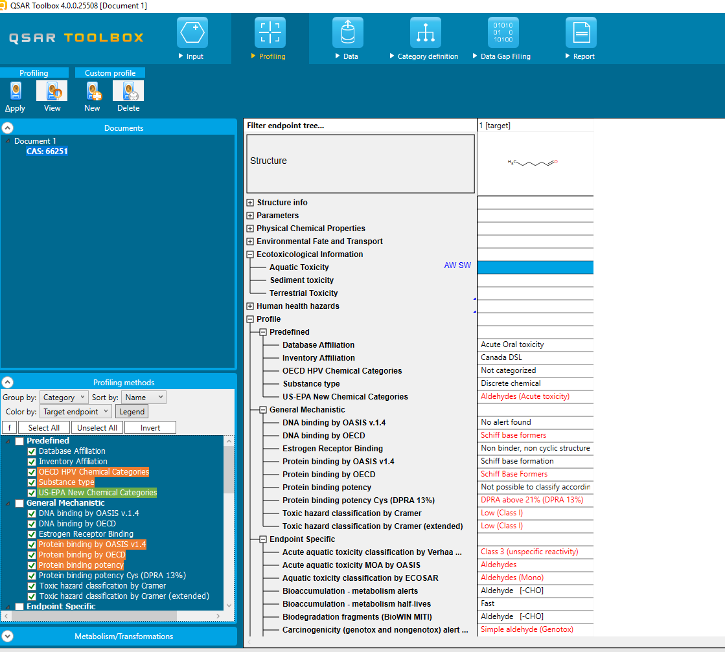
Profiling
Relevancy of profilers
Profiler relevancy with limited definition of the endpoint
Limited endpoint definition
Notes:
51

Slide 52
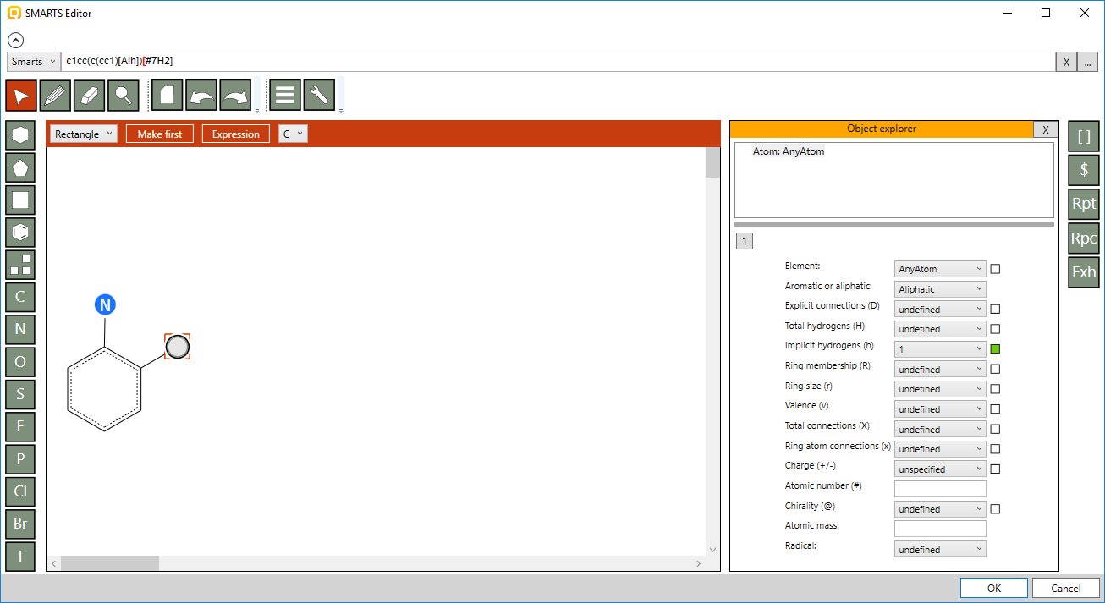
Profiling
SMARTS implementation
SMARTS editor
General Options
Automatic generation of SMARTS
Options for different fragments (repeated, recursive, etc.)
Options for atom characteristic (valence, charge, implicit hydrogens, etc.)
Drawing panel
Notes:
52

Slide 53
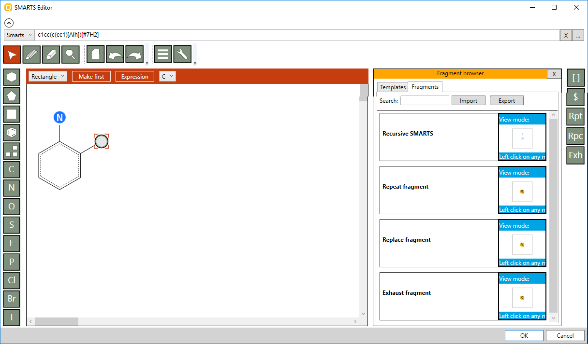
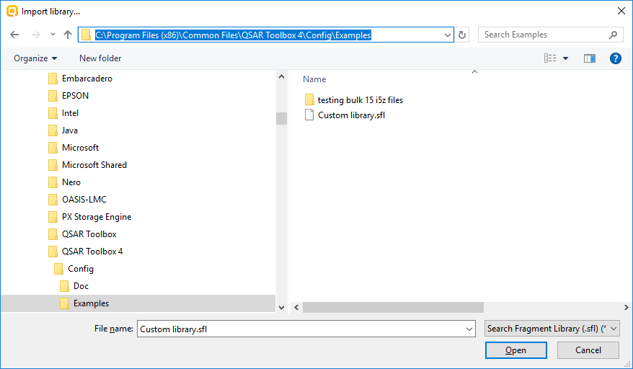
Profiling
SMARTS implementation
SMARTS editor
Import of library with SMARTS fragments
Import of SMARTS fragments library
Example file with SMARTS fragments is available in the “Examples” folder*
53
*Default installation location of the Examples folder: C:\Program Files (x86)\Common Files\QSAR Toolbox 4\Config\Examples
Notes:
53

Slide 54
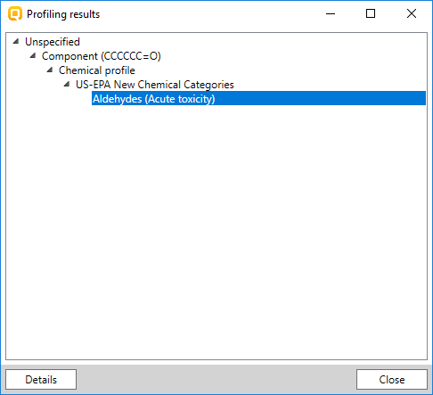
Profiling
Explain of mechanism of toxicity
Explain of profiling result for Hexanal by “US EPA New Chemical Categories” profiler
Notes:
54

Slide 55
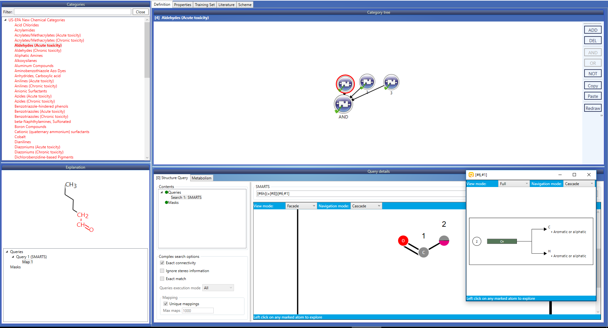
Profiling
Explain of mechanism of toxicity
Boundaries of the rule (structural, parametric, etc.)
Notes:
55

Slide 56
Profiling
Explain of mechanism of toxicity
Boundaries of the rule (structural, parametric, etc.)
Fragment found in the target structure
SMARTS for aldehyde
Notes:
56

Slide 57
Profiling
Explain of mechanism of toxicity
Log Kow < 6
Molecular weight < 1000 Da

Slide 58
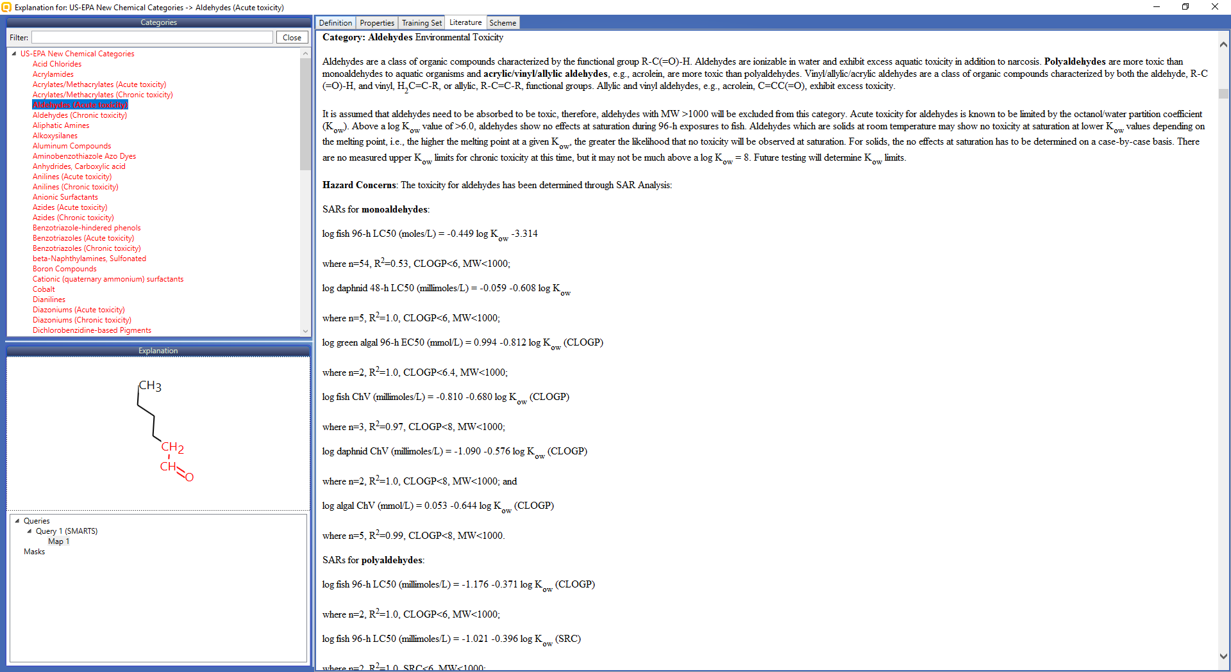
Profiling
Explain of mechanism of toxicity
Mechanistic justification of the rule

Slide 59
Profiling
Profiling groups
Predefined
General Mechanistic
Endpoint Specific
Empiric
Custom
59

Slide 60
Profiling
Profiling groups
Predefined
General Mechanistic
Endpoint Specific
Empiric
Custom
Molecular transformations
60

Slide 61
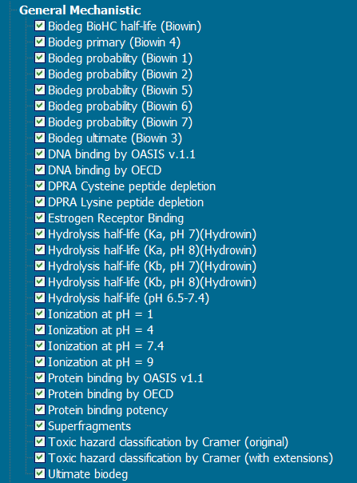
Profiling
Profiling groups
Predefined
General Mechanistic
Endpoint Specific
Empiric
Custom
Molecular transformations
61

Slide 62
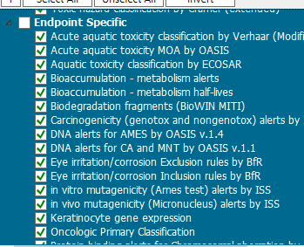
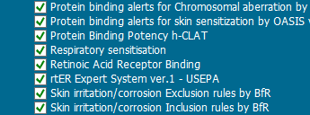
Profiling
Profiling groups
Predefined
General Mechanistic
Endpoint Specific
Empiric
Custom
Molecular transformations
62

Slide 63
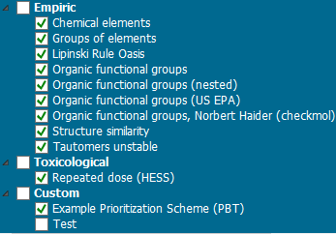
Profiling
Profiling groups
Predefined
General Mechanistic
Endpoint Specific
Empiric
Custom
Molecular transformations
63

Slide 64
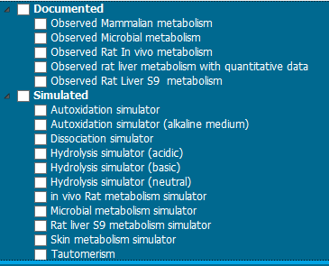
Profiling
Profiling groups
Predefined
General Mechanistic
Endpoint Specific
Empiric
Custom
Molecular transformations
64

Slide 65
Profiling
List with updated/new profilers
# | Title | Profiling group | Status
1 | Substance type | Predefined | updated
2 | DNA binding by OASIS v.1.4 | General Mechanistic | updated
3 | Protein binding by OASIS v.1.4 | General Mechanistic | updated
4 | Protein binding potency | General Mechanistic | updated
5 | Protein binding potency Cys (DPRA 13%) | General Mechanistic | updated
6 | Protein binding potency Lys (DPRA 13%) | General Mechanistic | updated
7 | Acute aquatic toxicity classification by Verhaar (Modified) | Endpoint Specific | updated
8 | Acute aquatic toxicity MOA by OASIS | Endpoint Specific | updated
9 | Carcinogenicity (genotox and nongenotox) alerts by ISS | Endpoint Specific | updated
10 | DNA alerts for AMES by OASIS v1.4 | Endpoint Specific | updated
11 | DNA alerts for CA and MNT by OASIS v.1.1 | Endpoint Specific | updated
12 | in vitro mutagenicity (Ames test) alerts by ISS | Endpoint Specific | updated
13 | in vivo mutagenicity (Micronucleus) alerts by ISS | Endpoint Specific | updated
14 | Keratinocyte gene expression | Endpoint Specific | updated
15 | Protein binding alerts for Chromosomal aberration by OASIS v1.2 | Endpoint Specific | updated
16 | Protein binding alerts for skin sensitization v.1.4 | Endpoint Specific | updated
17 | Organic Functional groups | Empiric | updated
18 | Organic Functional groups (nested) | Empiric | updated
19 | HESS Profiler | Empiric | updated
20 | Protein Binding Potency h-CLAT | Endpoint Specific | new
65

Slide 66
Profiling
List with updated/new metabolisms
Observed metabolism – new:
Observed rat liver metabolism with quantitative data
Simulators – updated:
Dissociation simulator
in vivo Rat metabolism simulator
Rat liver S9 metabolism simulator
66

Slide 67
Basic functionalities
Input
Structure - QA
Endpoint definition
Query tool (separate presentation – see “QSAR_Toolbox_4_Customized search_QT.ppt”)
Profiling
Relevancy of profilers
SMARTS implementation
Profiling groups
Data
Relevancy of databases
Data groups and documentation
Reliability scores of databases
Import/Export (separate presentation – see “QSAR_Toolbox_4_Import_Export data.ppt”)
Category definition
Alert performance – with and without accounting metabolism
Grouping with accounting for metabolism
Identification of activated metabolite representing target chemical
Data Gap Filling
Principle approaches for DGF
Automated and standardized workflows (separate presentation – see “QSAR_Toolbox_4_Workflows_for_Ecotox_and_Skin_ sens.pptx”)
Subcategorization
Endpoint vs. endpoint
Report
Data matrix
67
Notes:
67

Slide 68
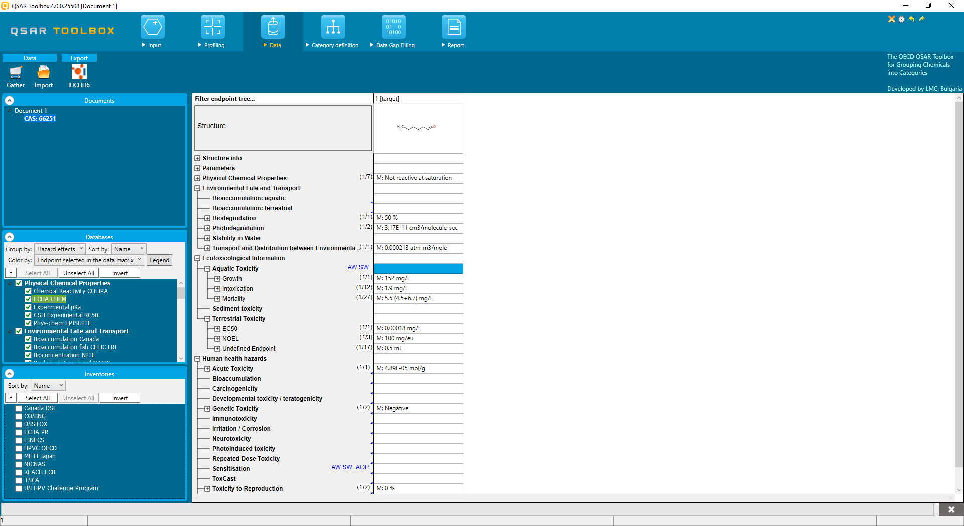
Data
Databases and Inventories
Databases – storage of structures with experimental data
Inventories – storage of structures
68
Notes:
68

Slide 69
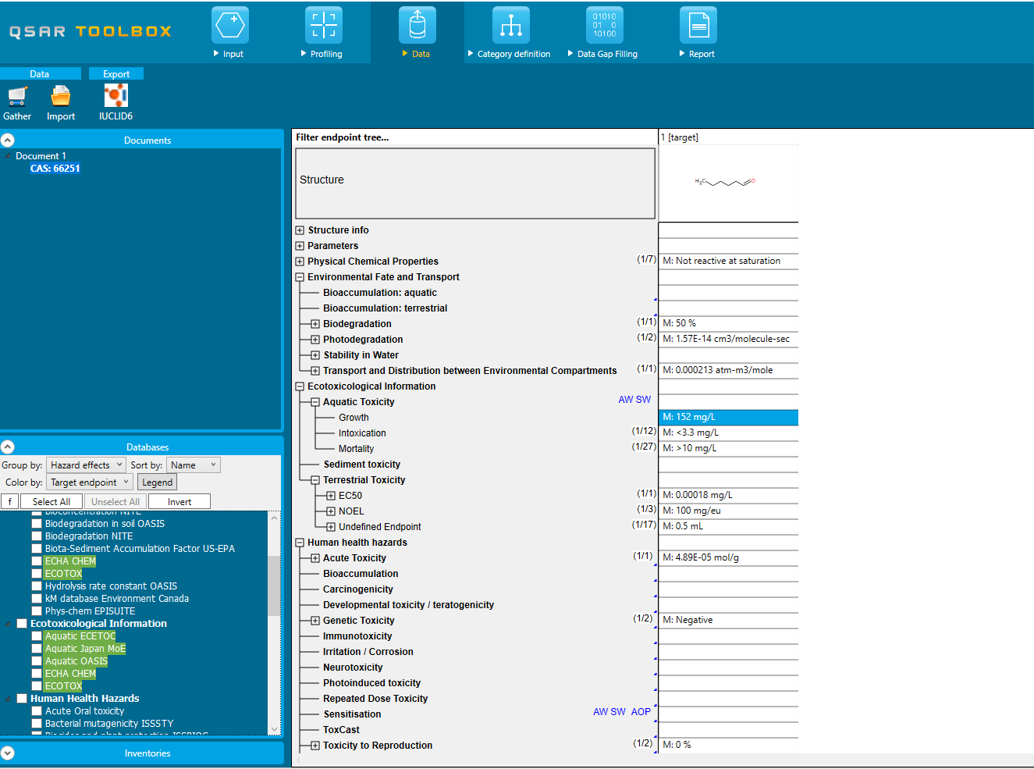
Data
Relevancy of databases
Highlights the databases where experimental data for the selected target endpoint is available
Limited endpoint definition (effect is defined only)
Expanded list of highlighted databases
69

Slide 70
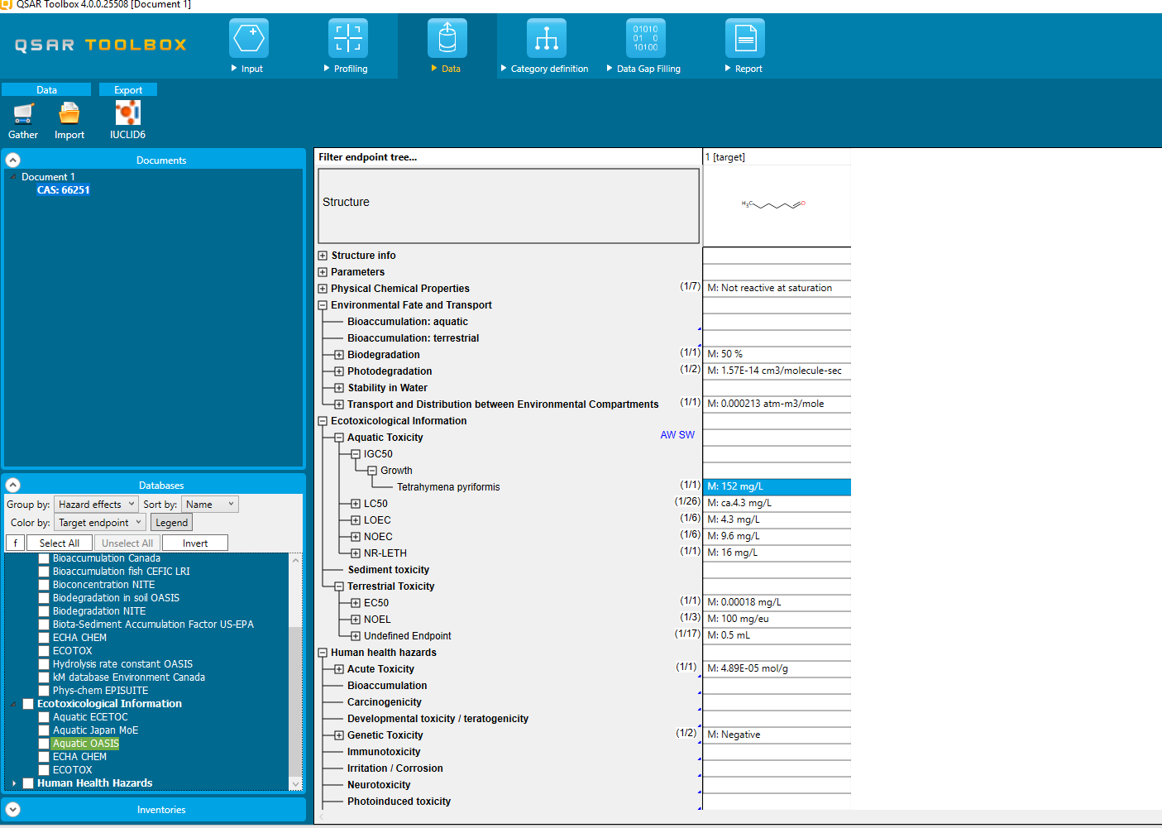
Data
Relevancy of databases
Highlights the databases where experimental data for the selected target endpoint is available
Complete endpoint definition (endpoint, effect, species are defined)
Databases are highlighted more accurately
70

Slide 71
Data
Data groups
Databases
Physical Chemical Properties
Environmental Fate and Transport
Ecotoxicological Information
Human Health Hazard
Inventories
71
Notes:
71

Slide 72
Data
Data groups
Databases
Physical Chemical Properties
Environmental Fate and Transport
Ecotoxicological Information
Human Health Hazard
Inventories
72
Notes:
72

Slide 73
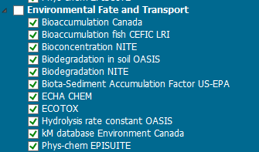
Data
Data groups
Databases
Physical Chemical Properties
Environmental Fate and Transport
Ecotoxicological Information
Human Health Hazard
Inventories
73
Notes:
73

Slide 74
Data
Data groups
Databases
Physical Chemical Properties
Environmental Fate and Transport
Ecotoxicological Information
Human Health Hazard
Inventories
74
Notes:
74

Slide 75
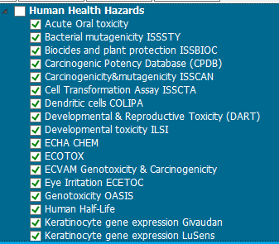
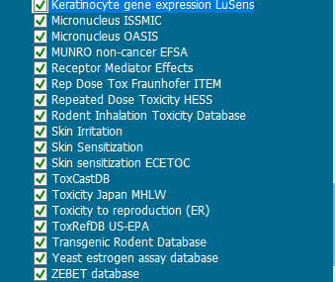
Data
Data groups
Databases
Physical Chemical Properties
Environmental Fate and Transport
Ecotoxicological Information
Human Health Hazard
Inventories
75
Notes:
75

Slide 76
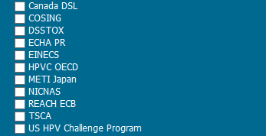
Data
Data groups
Databases
Physical Chemical Properties
Environmental Fate and Transport
Ecotoxicological Information
Human Health Hazard
Inventories
76
Notes:
76

Slide 77
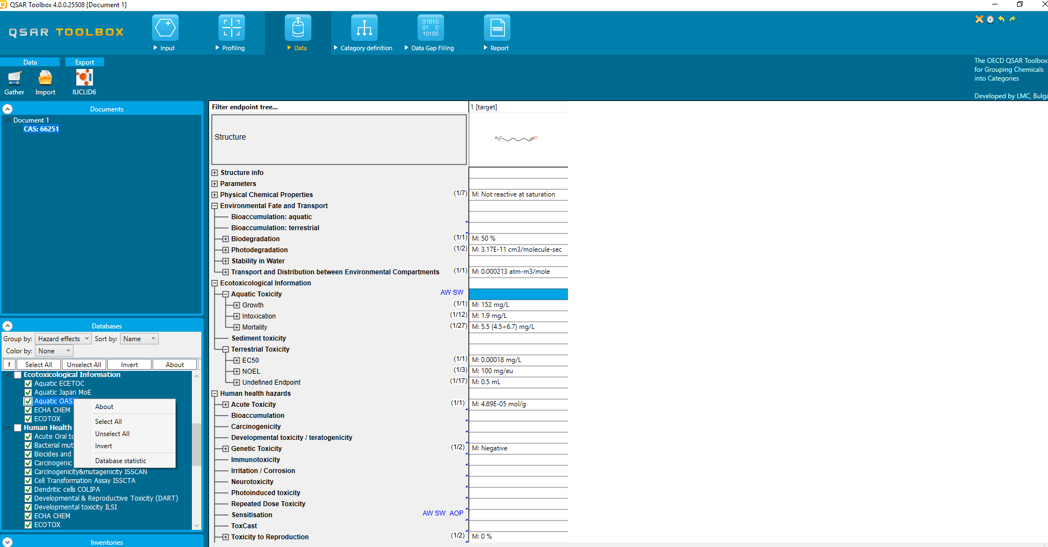
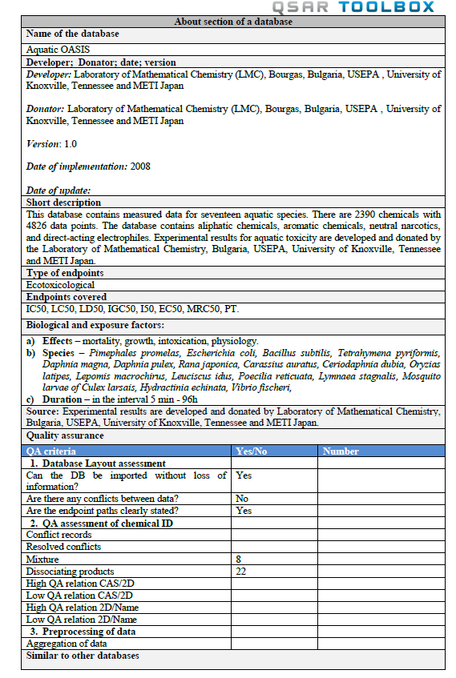
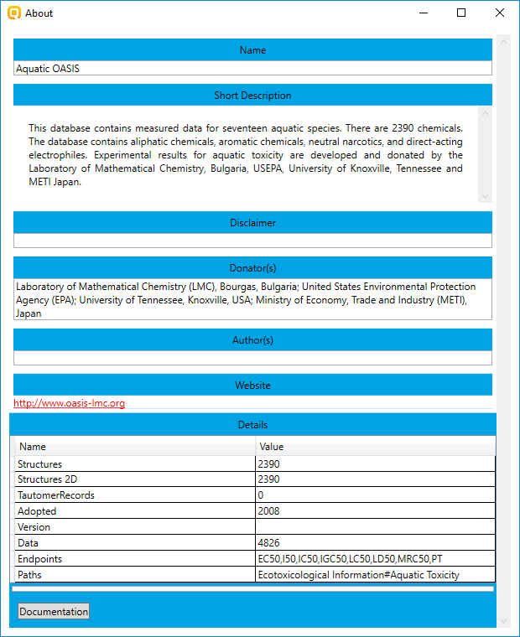
Data
Documentation of database
Documentation
About blank
77
77
Notes:
77

Slide 78
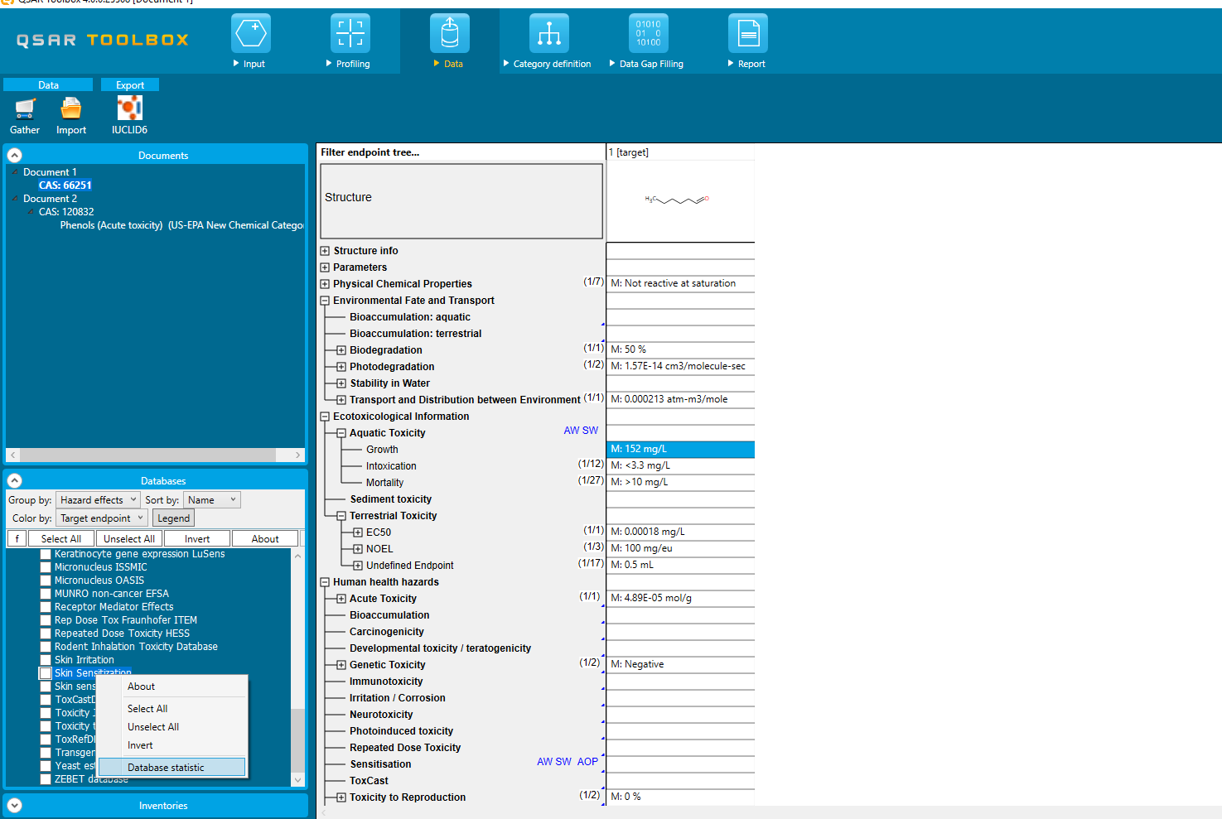
Data
Accuracy
Completeness
Contemporaneity
Consistency
Database reliability scores
Examples
Quality attributes
78

Slide 79
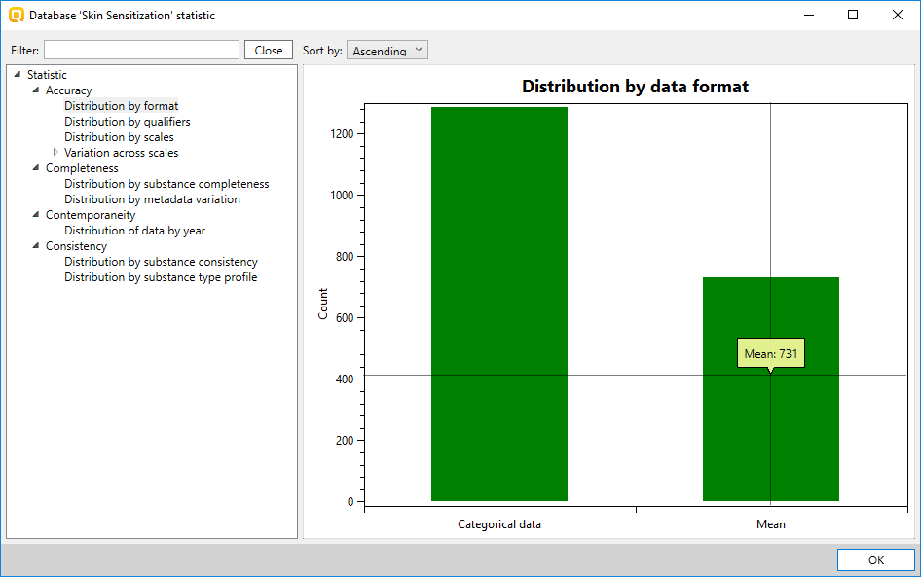
Data
Accuracy
Completeness
Contemporaneity
Consistency
Database reliability scores
Examples
Quality attributes
79

Slide 80
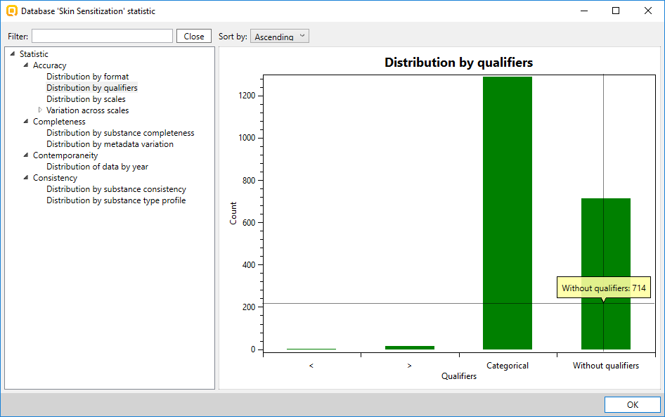
Data
Accuracy
Completeness
Contemporaneity
Consistency
Database reliability scores
Examples
Quality attributes
80

Slide 81
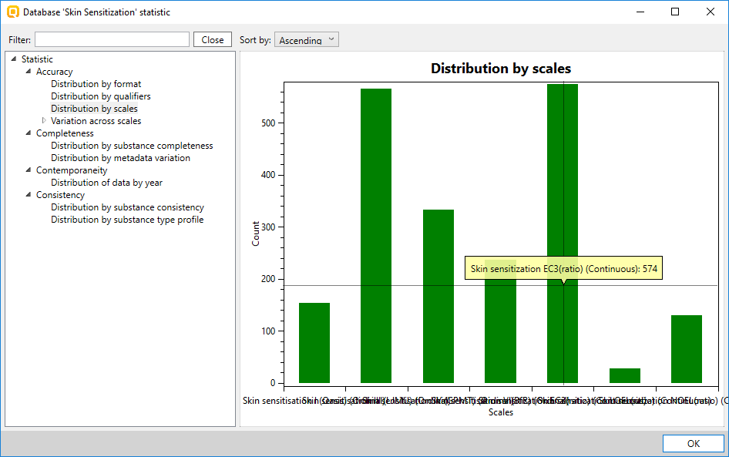
Data
Accuracy
Completeness
Contemporaneity
Consistency
Database reliability scores
Examples
Quality attributes
81

Slide 82
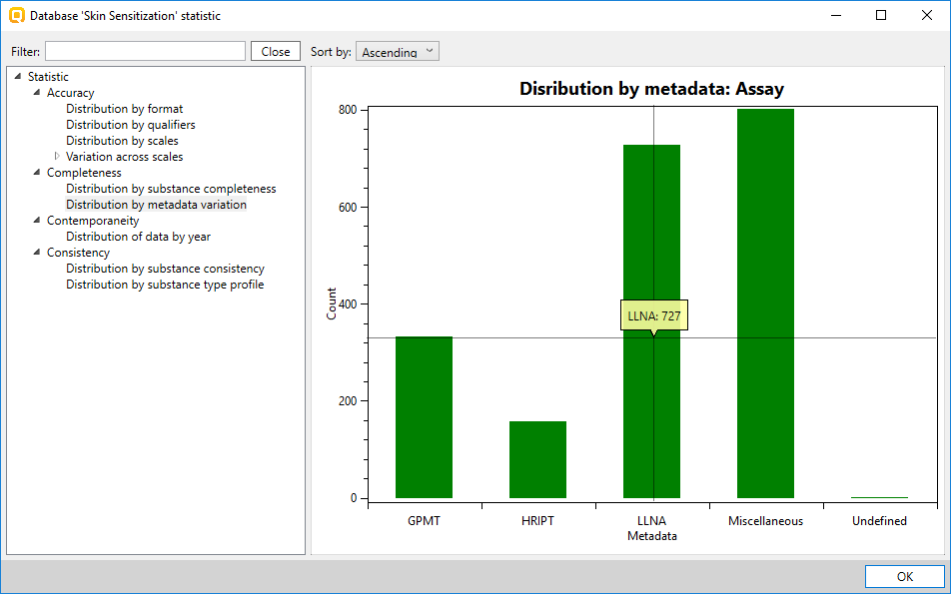
Data
Accuracy
Completeness
Contemporaneity
Consistency
Database reliability scores
Examples
Quality attributes
82

Slide 83
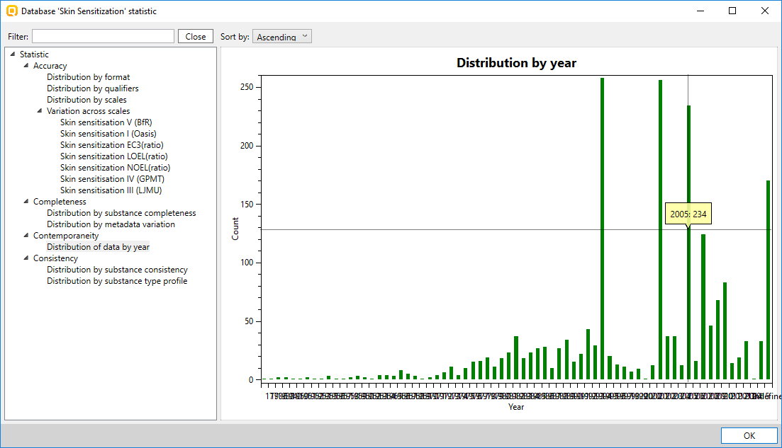
Data
Accuracy
Completeness
Contemporaneity
Consistency
Database reliability scores
Examples
Quality attributes
83

Slide 84
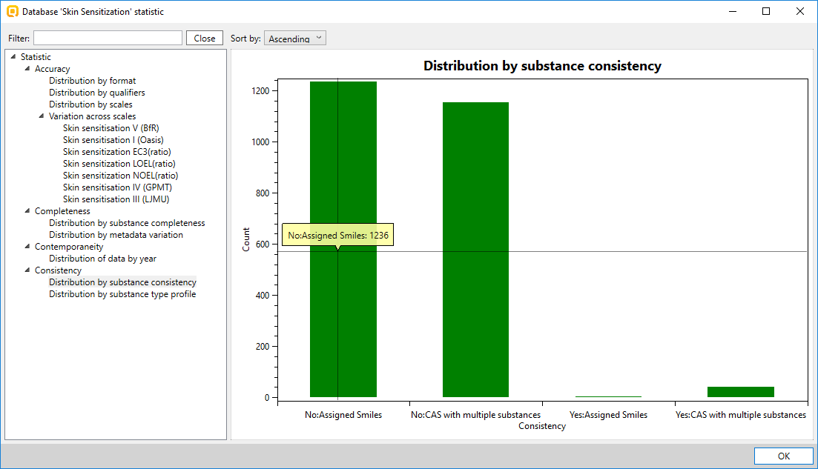
Data
Accuracy
Completeness
Contemporaneity
Consistency
Database reliability scores
Examples
Quality attributes
84

Slide 85
Data
Number of chemicals and data points in Toolbox 4.0
Databases | Toolbox 4.0
 | Chemicals | Data Points
Physical Chemical Properties | 45238 | 177258
Environmental Fate and Transport | 9446 | 97469
Ecotoxicological | 17649 | 856473
Human Health | 30447 | 912687
Total number | 79204 | 2043887
85

Slide 86
Data
Number of chemicals in the Inventories
Toolbox 4.0
Inventory | Number of chemical
Canada DSL | 22017
COSING | 1314
DSSTOX | 8606
ECHA PR | 142625
EINECS | 72561
HPVC OECD | 4843
METI Japan | 16133
NICNAS | 39694
REACH ECB | 74073
TSCA | 67570
US HPV Challenge Program | 9125
Total: | 203203
86

Slide 87
Basic functionalities
Input
Structure - QA
Endpoint definition
Query tool (separate presentation – see “QSAR_Toolbox_4_Customized search_QT.ppt”)
Profiling
Relevancy of profilers
SMARTS implementation
Profiling groups
Data
Relevancy of databases
Data groups and documentation
Reliability scores of databases
Import/Export (separate presentation – see “QSAR_Toolbox_4_Import_Export data.ppt”)
Category definition
Alert performance – with and without accounting metabolism
Grouping with accounting for metabolism
Identification of activated metabolite representing target chemical
Data Gap Filling
Principle approaches for DGF
Automated and standardized workflows (separate presentation – see “QSAR_Toolbox_4_Workflows_for_Ecotox_and_Skin_ sens.pptx”)
Subcategorization
Endpoint vs. endpoint
Report
Data matrix
87
Notes:
87

Slide 88
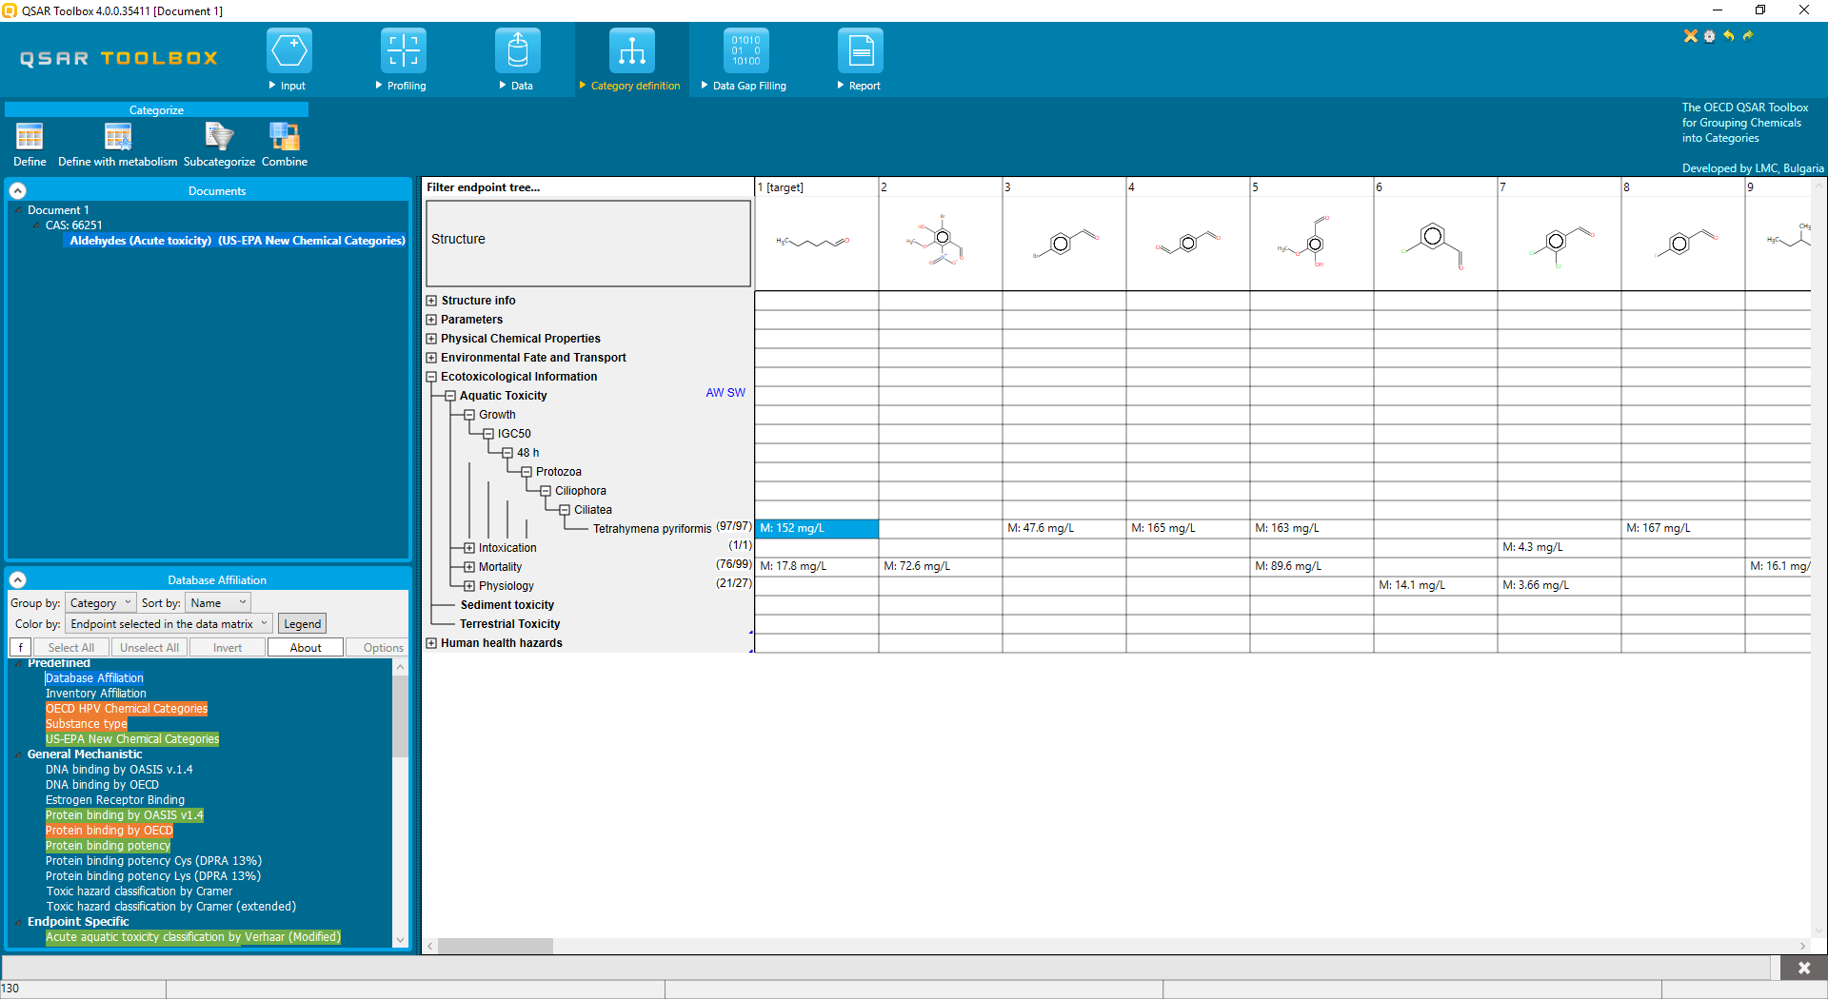
Category definition
Defining a group of analogues
Relevant to the selected target endpoint profilers are highlighted
88
Notes:
88

Slide 89
Category definition
Alert performance (AP)
Alert performance is used to define how much relevant to a target endpoint an alert is. It reflects the alerts usability for category formation and is applicable for the alerts of the following profilers:
US-EPA New Chemical categories with respect to Carcinogenicity
Biodeg probability (Biowin 5) with respect to Biodegradation
Protein binding alerts for skin sensitization by OASIS with respect to Skin sensitization
DNA alerts for AMES, MN and CA by OASIS with respect to AMES Mutagenicity
Calculation of AP could be implemented for each profiler
89
Notes:
89

Slide 90
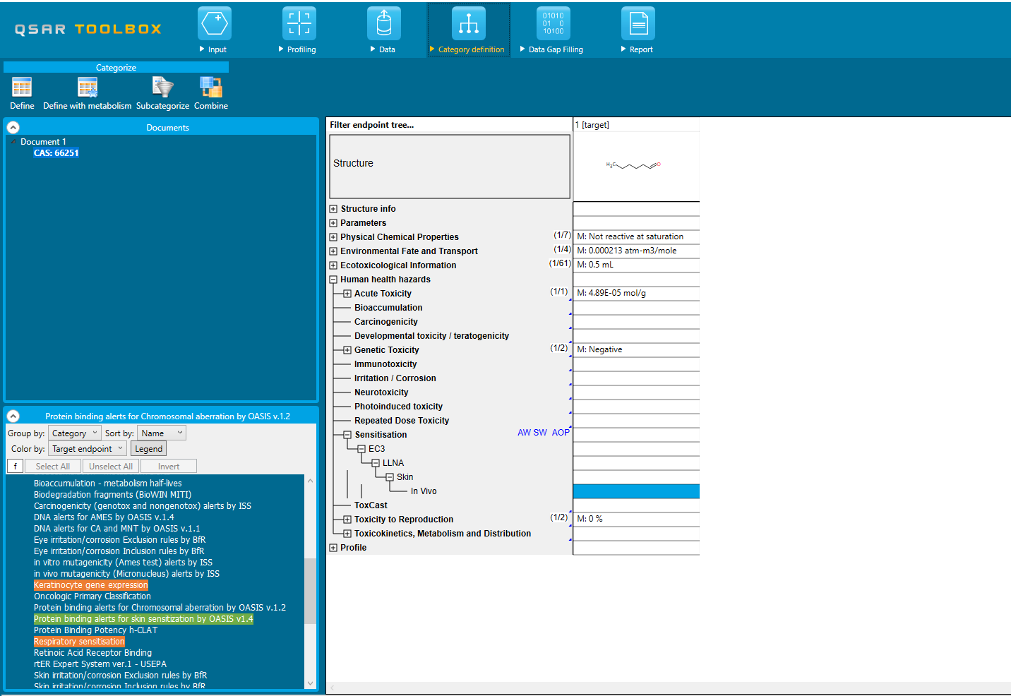
Category definition
Alert performance (AP) – without metabolic activation
Calculation of AP for protein binding alert associated to Skin sensitization
CAS 66-25-1
Target endpoint needs to be preliminary defined
Relevancy of the profilers (suitable, plausible and unknown) to selected target endpoint
90
Notes:
90

Slide 91
Category definition
Alert performance (AP) – without metabolic activation
Calculation of AP for protein binding alert associated to Skin sensitization
CAS 66-25-1
Target’s protein binding alert and mechanism associated with skin sensitization
List with scales for skin sensitization (Positive/Negative; Strong/Weak/Non)
Alert performance section
91
Notes:
91

Slide 92
Category definition
Alert performance (AP) – without metabolic activation
Calculation of AP for protein binding alert associated to Skin sensitization
CAS 66-25-1
Target’s protein binding alert and mechanism associated with skin sensitization
List with scales for skin sensitization (Positive/Negative; Strong/Weak/Non)
Alert performance section
Calculated AP using scale Positive/Negative
Calculated AP using scale Strong/Weak/Non
92
Notes:
92

Slide 93
Category definition
Alert performance (AP) – with metabolic activation
CAS 56-18-8
Calculation of AP for protein binding alert associated to Skin sensitization
Metabolism simulators highlighted by relevancy to selected target endpoint
Target endpoint
93
Notes:
93

Slide 94
Category definition
Alert performance (AP) – with metabolic activation
CAS 56-18-8
Calculation of AP for protein binding alert associated to Skin sensitization
List with generated metabolites
AP is calculated based on activated metabolites found in the package Parent & metabolites
94
Notes:
94

Slide 95
Category definition
Alert performance (AP) – with metabolic activation
CAS 56-18-8
Calculation of AP for protein binding alert associated to Skin sensitization
List with generated metabolites
Protein binding alert found in the package Parent & metabolites
95
Notes:
95

Slide 96
Category definition
Alert performance (AP) – with metabolic activation
CAS 56-18-8
Calculation of AP for protein binding alert associated to Skin sensitization
List with generated metabolites
List with scales for skin sensitization (Positive/Negative; Strong/Weak/Non)
96
Notes:
96

Slide 97
Category definition
Alert performance (AP) – with metabolic activation
CAS 56-18-8
Calculation of AP for protein binding alert associated to Skin sensitization
List with generated metabolites
List with scales for skin sensitization (Positive/Negative; Strong/Weak/Non)
Calculated AP using scale Positive/Negative
Calculated AP using scale Strong/Weak/Non
97
Notes:
97

Slide 98
Category definition
Grouping with accounting for metabolism
Grouping with accounting metabolic transformation is a procedure for finding analogues accounting metabolism activation of the chemicals
Toolbox 4.0 allows finding analogues that have:
parent and its metabolites with defined profile
metabolite with defined profile
exact metabolite
metabolite with defined parameter value
metabolite similar to defined one
combination of above
98
Notes:
98

Slide 99
Category definition
Grouping with accounting for metabolism
CAS 97-53-0
Analogues for Skin sensitization accounting metabolism
List with metabolism simulators highlighted by relevancy to selected target endpoint
99
Notes:
99

Slide 100
Category definition
Grouping with accounting for metabolism
CAS 97-53-0
Analogues for Skin sensitization accounting metabolism
Parent and each metabolites in separate rows
List with metabolism simulators highlighted by relevancy to selected target endpoint
Different queries for searching similar structures (see next slide for details)
Parent and metabolites as a package
100
Notes:
100

Slide 101
Category definition
Grouping with accounting for metabolism
CAS 97-53-0
Analogues for Skin sensitization accounting metabolism
None– default options; no criteria is set
Exact–provides opportunity to search for metabolites in the analogues having exact to the specified metabolite structure
Parametric – to have specific value or range of variation of defined parameter (a list with all parameters currently available in the Toolbox is provided)
Profile– to have specific category by selected profiler (a list with all profilers is provided)
Structural – to have specific similarity based on the atom centered fragments
101
Notes:
101

Slide 102
Category definition
Grouping with accounting for metabolism
CAS 97-53-0
Analogues for Skin sensitization accounting metabolism
List with metabolism simulators highlighted by relevancy to selected target endpoint
Parametric query: log Kow in range 0-4
Profile query: to have “Quinone” alert by Protein binding (“Edit” for more details)
Similarity query: Similarity ≥ 70% (adjust options from “Options)
102
Notes:
102

Slide 103
Category definition
Grouping with accounting for metabolism
CAS 97-53-0
Analogues for Skin sensitization accounting metabolism
Group with analogues found by accounting metabolism and setting different criteria for metabolites
Analogues found based on the criteria for parent and metabolites shown in previous slide
103

Slide 104
Category definition
Identification of activated metabolite representing target chemical
CAS 94-59-7
Example: Prediction of AMES Mutagenicity based on activated metabolite
Upfront metabolism: Allow to focus and make read across for a specific metabolite
104
Notes:
104

Slide 105
Category definition
Identification of activated metabolite representing target chemical
CAS 94-59-7
Example: Prediction of AMES Mutagenicity based on activated metabolite
List with observed Rat Liver S9 metabolites
Activated metabolite – DNA alert is identified
105

Slide 106
Category definition
Identification of activated metabolite representing target chemical
CAS 94-59-7
Example: Prediction of AMES Mutagenicity based on activated metabolite
List with observed Rat Liver S9 metabolites
Experimental data for in vitro Mutagenicity
Activated metabolite – DNA alert is identified
106

Slide 107
Category definition
Identification of activated metabolite representing target chemical
CAS 94-59-7
Example: Prediction of AMES Mutagenicity based on activated metabolite
Prediction for selected metabolite based on read across
Predicted Gene Mutation: Positive
107

Slide 108
Category definition
Identification of activated metabolite representing target chemical
CAS 94-59-7
Example: Prediction of AMES Mutagenicity based on activated metabolite
Prediction for parent chemical based on experimental and predicted results of metabolites
Predicted Gene Mutation: Positive
108

Slide 109
Basic functionalities
Input
Structure - QA
Endpoint definition
Query tool (separate presentation – see “QSAR_Toolbox_4_Customized search_QT.ppt”)
Profiling
Relevancy of profilers
SMARTS implementation
Profiling groups
Data
Relevancy of databases
Data groups and documentation
Reliability scores of databases
Import/Export (separate presentation – see “QSAR_Toolbox_4_Import_Export data.ppt”)
Category definition
Alert performance – with and without accounting metabolism
Grouping with accounting for metabolism
Identification of activated metabolite representing target chemical
Data Gap Filling
Principle approaches for DGF
Automated and standardized workflows (separate presentation – see “QSAR_Toolbox_4_Workflows_for_Ecotox_and_Skin_ sens.pptx”)
Subcategorization
Endpoint vs. endpoint
Report
Data matrix
109
Notes:
109

Slide 110
Data Gap Filling
Principle approaches for making data gap filling implemented in Toolbox
110

Slide 111
Data Gap Filling
Principle approaches for making data gap filling implemented in Toolbox
Read across: Averages the toxicity values of the closest analogues with respect to the bioavailability parameter
Automated and Standardized workflows (AW, SW) could be applied*
(Q)SAR: (Q)SAR models could be applied (e.g. ECOSAR models)
Trend analysis: Searches a linear relationship between observed toxicities of analogues with bioavailability parameter
111
*Currently available AW and SW are for predicting acute aquatic toxicity and skin sensitization

Slide 112
Data Gap Filling
Principle approaches for making data Gap Filling (DGF) implemented in Toolbox
Options of DGF
Options of DGF
112

Slide 113
Data Gap Filling
Principle approaches for making data Gap Filling (DGF) implemented in Toolbox
Options of DGF
113

Slide 114
Data Gap Filling
Principle approaches for making data Gap Filling (DGF) implemented in Toolbox
Trend analysis: Applicable for endpoint where a linear relationship between the endpoint and the parameter for bioavailability could be expected (e.g. Acute aquatic toxicity endpoints)
114

Slide 115
Data Gap Filling
Principle approaches for making data gap filling implemented in Toolbox
Trend analysis: Applicable for endpoint where a linear relationship between the endpoint and the parameter for bioavailability could be expected (e.g. Acute aquatic toxicity endpoints)
Subcategorization dialogue – refining of the category by applying the existing knowledge
Relevant to the endpoint subcategorizations are highlighted
115

Slide 116
Data Gap Filling
Principle approaches for making data gap filling implemented in Toolbox
Trend analysis: Applicable for endpoint where a linear relationship between the endpoint and the parameter for bioavailability could be expected (e.g. Acute aquatic toxicity endpoints)
Explain of toxic mechanism in the Subcategorization
116

Slide 117
Data Gap Filling
Principle approaches for making data gap filling implemented in Toolbox
Trend analysis: Applicable for endpoint where a linear relationship between the endpoint and the parameter for bioavailability could be expected (e.g. Acute aquatic toxicity endpoints)
Explain of toxic mechanism in the Subcategorization
117

Slide 118
Data Gap Filling
Principle approaches for making data gap filling implemented in Toolbox
Trend analysis: Applicable for endpoint where a linear relationship between the endpoint and the parameter for bioavailability could be expected (e.g. Acute aquatic toxicity endpoints)
Explain of toxic mechanism in the Subcategorization
Mechanistic justification of the toxic mechanism: Michael addition on conjugated systems with electron withdrawing groups
118

Slide 119
Data Gap Filling
Principle approaches for making data gap filling implemented in Toolbox
Trend analysis: Applicable for endpoint where a linear relationship between the endpoint and the parameter for bioavailability could be expected (e.g. Acute aquatic toxicity endpoints)
Predicted IGC50 is 81.9 mg/l based on Trend analysis
119

Slide 120
Data Gap Filling
Principle approaches for making data gap filling implemented in Toolbox
Trend analysis: Applicable for endpoint where a linear relationship between the endpoint and the parameter for bioavailability could be expected (e.g. Acute aquatic toxicity endpoints)
Details of the prediction
120

Slide 121
Data Gap Filling
Principle approaches for making data gap filling implemented in Toolbox
Trend analysis: Applicable for endpoint where a linear relationship between the endpoint and the parameter for bioavailability could be expected (e.g. Acute aquatic toxicity endpoints)
Helpers
Helpers appear in some cases showing actions that could be fulfilled as first steps for the refinement of the category
121

Slide 122
Data Gap Filling
Principle approaches for making data gap filling implemented in Toolbox
Trend analysis: Applicable for endpoint where a linear relationship between the endpoint and the parameter for bioavailability could be expected (e.g. Acute aquatic toxicity endpoints)
Helpers
The system compares data values, which are in the volume concentration unit family, against their calculated maximum water solubility in order to detect artificial data points which could be removed
Data with qualifiers
Differences by Substance type
Prediction is acceptable according to the statistic
122

Slide 123
Data Gap Filling
Principle approaches for making data gap filling implemented in Toolbox
Read across: Averages the toxicity values of the closest analogues with respect to the bioavailability parameter
Predicted IGC50 is 93.1 mg/l based on Read across
123

Slide 124
Data Gap Filling
Endpoint vs. endpoint
Allows to:
define correlation between different endpoints, e.g. AMES mutagenicity and Skin sensitization, in chemico reactvity (DPRA) and Skin sensitization EC3, short term vs. long term toxicity tests, etc.
analyze the data correlation of specific classes of chemicals
Examples are shown in next few slides
124

Slide 125
Data Gap Filling
Endpoint vs. endpoint
Acute oral toxicity (LD50) vs. Acute short term toxicity to fish (LC50)
All chemical classes correlation
Statistic
125

Slide 126
Data Gap Filling
Endpoint vs. endpoint
Acute oral toxicity (LD50) vs. Acute short term toxicity to fish (LC50)
Subcategorization by Organic functional groups and selection of Tertiary Aliphatic amines
126

Slide 127
Data Gap Filling
Endpoint vs. endpoint
Acute oral toxicity (LD50) vs. Acute short term toxicity to fish (LC50)
Tertiary Aliphatic Amines correlation
Statistic
127

Slide 128
Data Gap Filling
Endpoint vs. endpoint
Repeated dose toxicity (LOEL) vs. Acute oral toxicity (LD50)
All chemical classes correlation
128

Slide 129
Data Gap Filling
Endpoint vs. endpoint
Repeated dose toxicity (LOEL) vs. Acute oral toxicity (LD50)
Tertiary Aliphatic Amines correlation
129

Slide 130
Data Gap Filling
Endpoint vs. endpoint
AC50 Estrogen receptor vs. AC50 Reporter Gene Assay ERα Agonist (Toxcast data)
130

Slide 131
Data Gap Filling
Document tree manipulation
Allows to move up and down through document levels and do different actions
The name of the document level shows the main action that is done on current level
Move to upper level and start different subcategorization
131
Notes:
131

Slide 132
Basic functionalities
Input
Structure - QA
Endpoint definition
Query tool (separate presentation – see “QSAR_Toolbox_4_Customized search_QT.ppt”)
Profiling
Relevancy of profilers
SMARTS implementation
Profiling groups
Data
Relevancy of databases
Data groups and documentation
Reliability scores of databases
Import/Export (separate presentation – see “QSAR_Toolbox_4_Import_Export data.ppt”)
Category definition
Alert performance – with and without accounting metabolism
Grouping with accounting for metabolism
Identification of activated metabolite representing target chemical
Data Gap Filling
Principle approaches for DGF
Automated and standardized workflows (separate presentation – see “QSAR_Toolbox_4_Workflows_for_Ecotox_and_Skin_ sens.pptx”)
Subcategorization
Endpoint vs. endpoint
Report
Data matrix
132
Notes:
132

Slide 133
Report
Generation of report of a prediction accommodating the information from the Toolbox
Prediction for reporting is available
133
Notes:
133

Slide 134
Report
Generation of report of a prediction accommodating the information from the Toolbox
Report dialogue - wizard
Report dialogue
Report sections
134
Notes:
134

Slide 135
Report
Customize what to appear in the report
Report dialogue - wizard
Editable fields for person details and summary prediction
Editable fields for mechanistic interpretation and adequacy of the prediction
Possibility to add profiling result from the existing profilers for the target
Possibility to add parameters, profiling result and other experimental data for the analogues
Additional appendices could be generated
135
Notes:
135

Slide 136
Report
View of report pages

Slide 137
Report
Data matrix supporting the report
Target chemical
Analogues
Additional parameters
Data used for the prediction
Additional experimental data

Slide 138
Outlook
Description
General scheme and workflow
Basic functionalities
Forming categories
138
Notes:
138

Slide 139
How to build categories?
139

Slide 140
Basic guidance for category formation
Recommended categorization phases:
Phase I. Endpoint non-specific - structure-related profilers (primary categorization)
Phase II. Endpoint specific profilers (for subcategorization) – based on endpoint driving interaction mechanisms
Phase II. Additional structure-related profilers, to further eliminate dissimilar chemicals (to increase the consistency of category)
140
Notes:
140

Slide 141
Recommended Categorization Phases
Phase I. Structure based
US EPA Categorization
OECD Categorization
Organic functional group
Structural similarity
ECOSAR
Broad grouping
Endpoint Non-specific
Repeating Phase I due to Multifunctionality of chemicals
141

Slide 142
Recommended Categorization Phases
Phase I. Structure based
US EPA Categorization
OECD Categorization
Organic functional group
Structural similarity
ECOSAR
Broad grouping
Endpoint Non-specific
Repeating Phase I due to Multifunctionality of chemicals
Phase II. Mechanism based
DNA binding mechanism
Protein binding mechanism
Mode of action –acute aquatic toxicity
Genotoxicity/carcinogenicity
Cramer rules
Verhaar rule
Skin/eye irritation corrosion rules
Subcategorization
Endpoint Specific
Metabolism accounted for
142

Slide 143
Recommended Categorization Phases
Phase I. Structure based
US EPA Categorization
OECD Categorization
Organic functional group
Structural similarity
ECOSAR
Broad grouping
Endpoint Non-specific
Repeating Phase I due to Multifunctionality of chemicals
Phase II. Mechanism based
DNA binding mechanism
Protein binding mechanism
Mode of action –acute aquatic toxicity
Genotoxicity/carcinogenicity
Cramer rules
Verhaar rule
Skin/eye irritation corrosion rules
Subcategorization
Endpoint Specific
Metabolism accounted for
Phase III. Eliminating dissimilar chemicals
Subcategorization
Endpoint Specific
Apply Phase I categorization
143

Slide 144
Basic guidance for category formation
Suitable categorization phases:
Phase I. Endpoint non-specific - structure-related profilers (primary categorization)
Phase II. Endpoint specific profilers (for subcategorization) – based on endpoint driving interaction mechanisms
Phase II. Additional structure-related profilers, to further eliminate dissimilar chemicals (to increase the consistency of category)
Performing categorization:
The categorization phases should be applied successively
The application order of the phases depend on the specificity of the data gap filling performed (data availability, endpoint specificity)
More categories of same phase could be used in forming categories
Some of the phases could be skipped if consistency of category members is reached
Subcategorization should be applied at Data gap filling stage
144
Notes:
144

