Slide 1
Automated and Standardized workflows for predicting Acute aquatic toxicity and Skin sensitization
Laboratory of Mathematical Chemistry,
Bourgas University “Prof. Assen Zlatarov”
Bulgaria

Slide 2
Outlook
Endpoints
Specificities
Components
Executing module
Algorithm of Ecotoxicological workflow
Predicting Ecotoxicity by using the workflows - examples
Algorithm of Skin sensitization workflow
Predicting Skin sensitization by using the workflows - examples
Notes:
2

Slide 3
Outlook
Endpoints
Specificities
Components
Executing module
Algorithm of Ecotoxicological workflow
Predicting Ecotoxicity by using the workflows - examples
Algorithm of Skin sensitization workflow
Predicting Skin sensitization by using the workflows - examples
Notes:
3

Slide 4
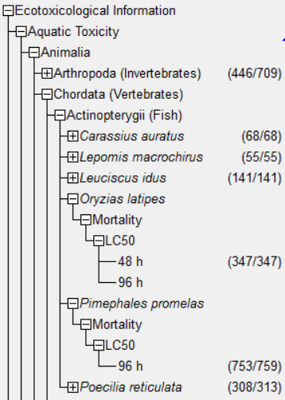
Automated and Standardized workflows in Toolbox v.4.2
Endpoints
Acute aquatic toxicity – Domain of application
Sub-hazard – Aquatic toxicity
Effect – Mortality, Intoxication, Immobilization, Growth, Population
Endpoint – LC50;EC50; IC50
Duration: 48 - 96 h
Species:
all fish: P. promelas, P. reticulate, etc.
Crustaceans
Green algae
Standardized workflow
Automated workflow

Slide 5
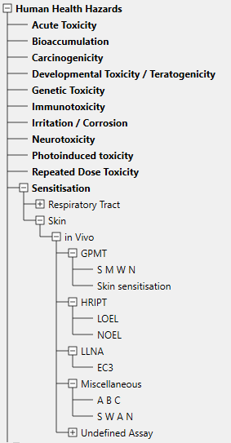
Automated and Standardized workflows in Toolbox v.4.2
Endpoints
Skin sensitization – Domain of application
Sub-hazard – Skin sensitization
Method – in vivo
Assays – LLNA + GPMT, LLNA only, GPMT only
Endpoint – EC3 + SMWN converted in dichotomous scale
Automated workflow
Standardized workflow
Automated workflow

Slide 6
Outlook
Endpoints
Specificities
Components
Executing module
Algorithm of Ecotoxicological workflow
Predicting Ecotoxicity by using the workflows - examples
Algorithm of Skin sensitization workflow
Predicting Skin sensitization by using the workflows - examples
Notes:
6

Slide 7
Automated and Standardized workflows in Toolbox v.4.2
Specificities
Automated workflow (AW)
On the fly data gap filling – the user is not able to control the workflow
Input information – only target chemical ID
Independency – application is not affected by the user activities (proceeding or subsequent)
Batch mode execution
Standardized workflow (SW)
Applicability domain of SW is expanded as compared to the AWs, including additional endpoints, effects, durations and species.
The SWs follow same steps as in the AWs.
The SWs stop at the each step of the workflows allowing the user to make different selection.

Slide 8
Outlook
Endpoints
Specificities
Components
Executing module
Algorithm of Ecotoxicological workflow
Predicting Ecotoxicity by using the workflows - examples
Algorithm of Skin sensitization workflow
Predicting Skin sensitization by using the workflows - examples
Notes:
8

Slide 9
Automated and Standardized workflows in Toolbox v.4.2
Components
AW
SW
Input
Input
Databases with data for the target endpoint are listed and user select to use all of them or make specific selection
Profiling
Same components as defined in the AW are used in the SW
Profiling
STOP
Data
Data
Relevant to the workflow profilers appropriate for DGF are listed and ordered hierarchically based on the population of the group and user is able to select any of them
The SW pauses at each of the stages and user is able to make different selection than those implemented in the AW
STOP
Category definition
Category definition
STOP
Data gap filling
Data gap filling
Additional data filtering could be applied (e.g. different species selection)
Reporting
Reporting

Slide 10
Outlook
Endpoints
Specificities
Components
Executing module
Algorithm of Ecotoxicological workflow
Predicting Ecotoxicity by using the workflows - examples
Algorithm of Skin sensitization workflow
Predicting Skin sensitization by using the workflows - examples
Notes:
10

Slide 11
Automated and Standardized workflows in Toolbox v.4.2
Executing module
The AWs and SWs are controlled by the “Workflow controller”
The workflow is navigated by two main buttons:
Continue/Pause allowing to continue or pause the workflow
Stop which cancel (deactivate) the workflow.
The algorithm of the current workflow could be seen by the Documentation button.
Additionally, all actions that are done during the execution of the workflow are tracked down and could be seen in the “Show action log”.

Slide 12
Outlook
Endpoints
Specificities
Components
Executing module
Algorithm of Ecotoxicological workflow
Predicting Ecotoxicity by using the workflows - examples
Algorithm of Skin sensitization workflow
Predicting Skin sensitization by using the workflows - examples
Notes:
12

Slide 13
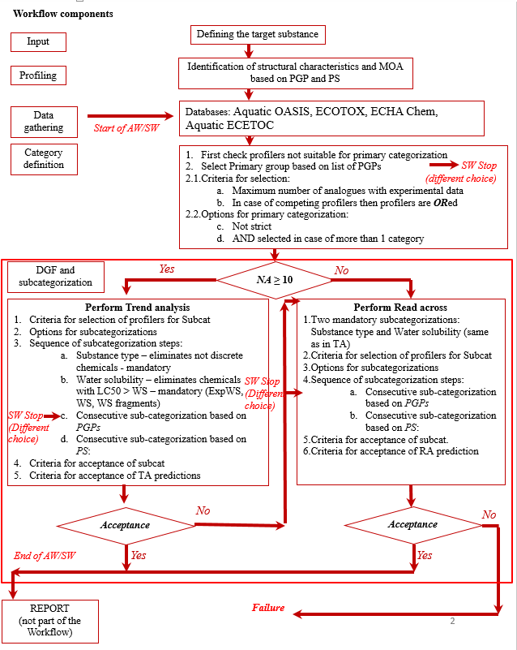
Automated and Standardized workflows in Toolbox v.4.2
Algorithm of Ecotoxicological workflow

Slide 14
Automated and Standardized workflows in Toolbox v.4.2
Algorithm of Ecotoxicological workflow
Databases
Aquatic OASIS (used in AW)
Aquatic ECETOX (used in AW)
ECOTOX (used in AW)
ECHA CHEM (used in AW)
Aquatic Japan*
*Aquatic japan MoE is not used in the AW because there are no data for L(E)C50, 96h, Pimephales promelas, Mortality

Slide 15
Automated and Standardized workflows in Toolbox v.4.2
Algorithm of Ecotoxicological workflow
Profilers used for primary categorization:
US EPA New Chemical Categories
Acute aquatic toxicity classification by Verhaar (Modified)
Acute aquatic toxicity MOA by OASIS
Aquatic toxicity classification by ECOSAR
Organic functional groups (OFG)
Organic functional groups US-EPA,
Organic functional groups, Norbert Haider
Options for primary categorization:
Maximum number of analogues with experimental data
In case of competing profilers then profilers are ORed

Slide 16
Automated and Standardized workflows in Toolbox v.4.2
Algorithm of Ecotoxicological workflow
Data Gap Filling
Trend analysis is the default approach
Read across is applied if:
Prediction by Trend analysis is not acceptable, or
The number of analogues is < 10
Gap filling and subcategorizations are sequence of logical operations (if, then), combined with criteria for acceptance.

Slide 17
Automated and Standardized workflows in Toolbox v.4.2
Algorithm of Ecotoxicological workflow
Subcategorization
The aim is to increase the similarity of analogues with the target
It is consecutive process of application of primary grouping profilers (PGPs) and profilers for subcategorization (PS)
Hierarchy of application of PGPs and PS depends on the number of analogues they have collected
Sub-categorization process is based on:
Sequence of subcategorization steps
Criteria for acceptance of subcategorization steps
PGPs – primary grouping profilers
PS – profilers for subcategorization

Slide 18
Automated and Standardized workflows in Toolbox v.4.2
Algorithm of Ecotoxicological workflow
Subcategorization
Sequence of subcategorization steps
Substance type – eliminates not discrete chemicals
Water solubility (WSKOWWIN + WATERNT)
– eliminates chemicals with LC50 > WS
Consecutive sub-categorization based on PGPs:
US EPA,
Verhaar,
MOA,
ECOSAR,
OFG (without nested)
4. Consecutive sub-categorization based on PS:
Protein binding (OASIS + OECD),
Chemical elements,
Str. Similarity* (remove all constituents with similarity <50%)
*Default options: Dice, Atom centered fragments

Slide 19
Automated and Standardized workflows in Toolbox v.4.2
Algorithm of Ecotoxicological workflow
Subcategorization
Criteria for acceptance of subcategorization step:
Depends on the specific statistical and structural criteria (e.g, experimental error, 95% of residuals, log K_{OW}, range of variation of the analogues etc.)
Criteria are different for RA and TA

Slide 20
Automated and Standardized workflows in Toolbox v.4.2
Algorithm of Ecotoxicological workflow
Criteria for acceptance of prediction
Trend analysis
After sub-categorization by all PGPs and PS
IF (R² ≥ 0.7 and NA ≥ 10)
THEN accept the prediction and generate report,
ELSE switch to Read across
Read-across
After sub-categorization by all PGPs and PS
IF Interpolation AND LC50 ≤ 2 log units OR log Kow ≤ 2 log units AND NA ≥ 5
THEN accept prediction and proceed with Report
In case, criteria are not met, then no prediction is obtained
Definitions
R² – Correlation coefficient
Interpolation: log K_{OW} of the target should be within the range of log K_{OW} of analogues
LC50 ≤ 2: for the 5 closest analogues the range of variation of LC50 is ≤ 2 log units
log K_{OW} ≤ 2: for the 5 closest analogues the range of variation of log K_{OW} is ≤ 2 log units
NA – Number of analogues

Slide 21
Outlook
Endpoints
Specificities
Components
Executing module
Algorithm of Ecotoxicological workflow
Predicting Ecotoxicity by using the workflows - examples
Algorithm of Skin sensitization workflow
Predicting Skin sensitization by using the workflows - examples
Notes:
21

Slide 22
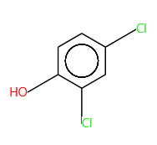
Automated and Standardized workflows in Toolbox v.4.2
SW for Ecotoxicological endpoint - example
Target chemical: CAS 120-83-2
Endpoint: LC50 or EC50
Effect: Mortality
Species: Actinopergyii (all fish) – illustrated in SW
Species: Pimephales promelas – illustrated in AW
Duration: 48h

Slide 23
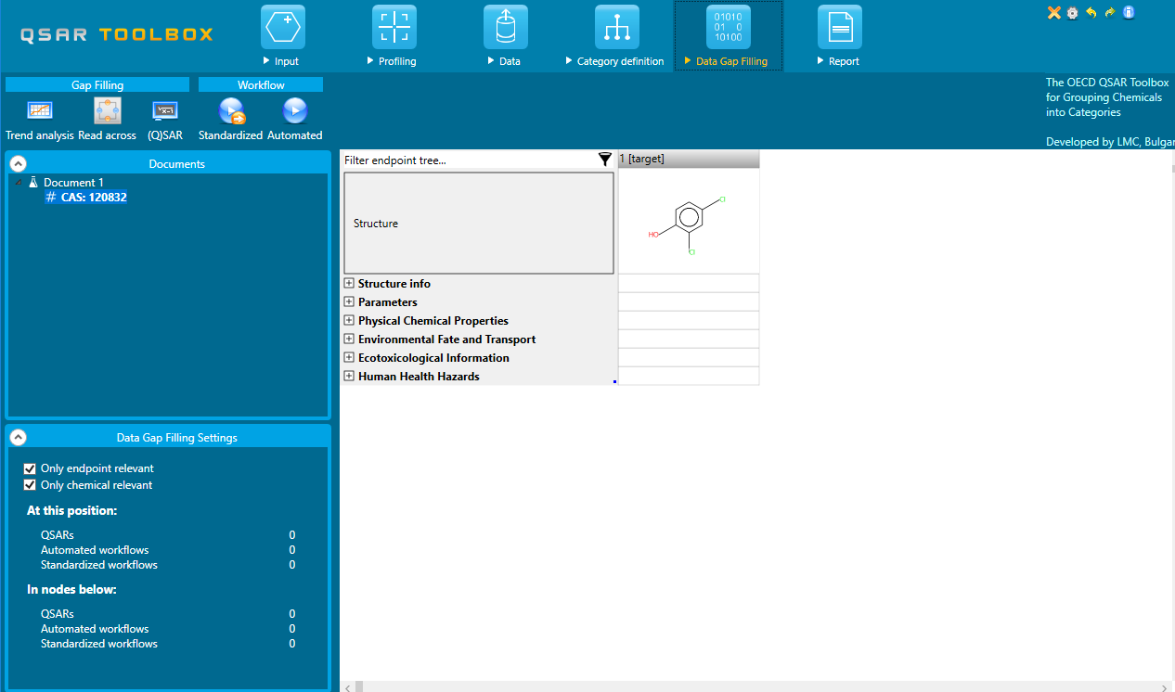
Automated and Standardized workflows in Toolbox v.4.2
SW for Ecotoxicological endpoint - example
Location: The AWs and SWs are part of the DGF
Automated workflow
Standardized workflow

Slide 24
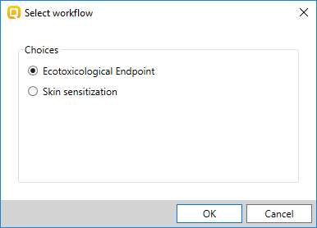
Automated and Standardized workflows in Toolbox v.4.2
SW for Ecotoxicological endpoint - example
Activation: The Standardized workflow is activated by clicking on the corresponding button
Standardized workflow
List with available workflows

Slide 25
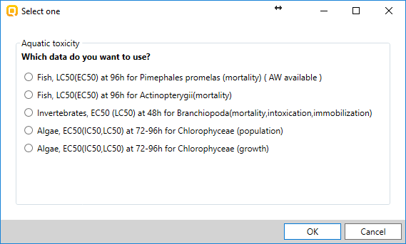
Automated and Standardized workflows in Toolbox v.4.2
SW for Ecotoxicological endpoint - example
Selection of endpoint: The SW for Ecotoxicological endpoint needs the endpoint to be confirmed. There are 5 options for endpoint selection. In our case study we apply SW for:
Endpoint: EC50 or LC50 for Fish, duration: 96h
Selection of endpoint for execution of SW

Slide 26
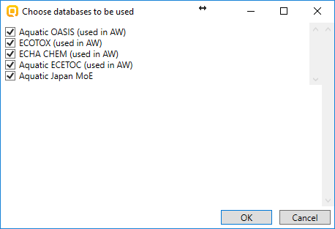
Automated and Standardized workflows in Toolbox v.4.2
SW for Ecotoxicological endpoint - example
Selection of databases: Five databases are available. All of them are selected in this example
Selection of databases

Slide 27
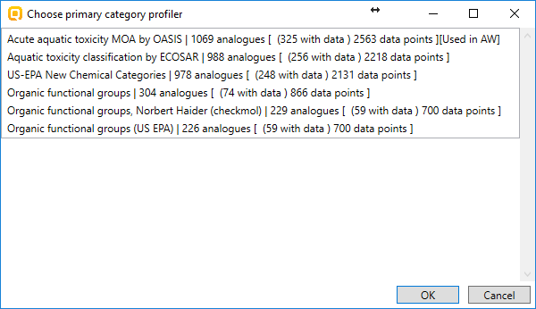
Automated and Standardized workflows in Toolbox v.4.2
SW for Ecotoxicological endpoint - example
Category definition:
Categories are hierarchically order depending on the number of analogues with data
The most populated category is used in the AW
In SW the user is able to make different selection
In this example we apply Acute aquatic toxicity MOA
Selection of primary grouping: MOA

Slide 28
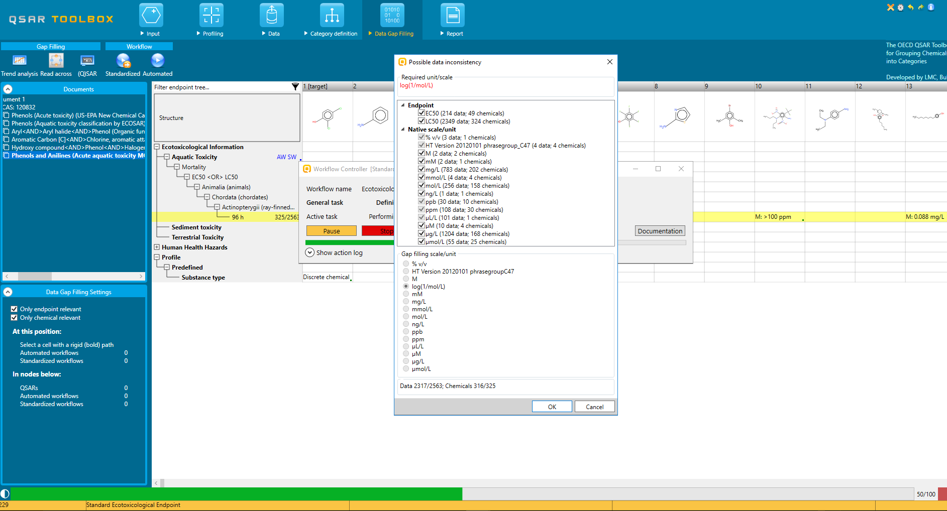
Automated and Standardized workflows in Toolbox v.4.2
SW for Ecotoxicological endpoint - example
Data Gap Filling: Before entering to DGF, the workflow allows filtering of duration; endpoint and unit
Filtering of data: keep EC50 and LC50 data

Slide 29
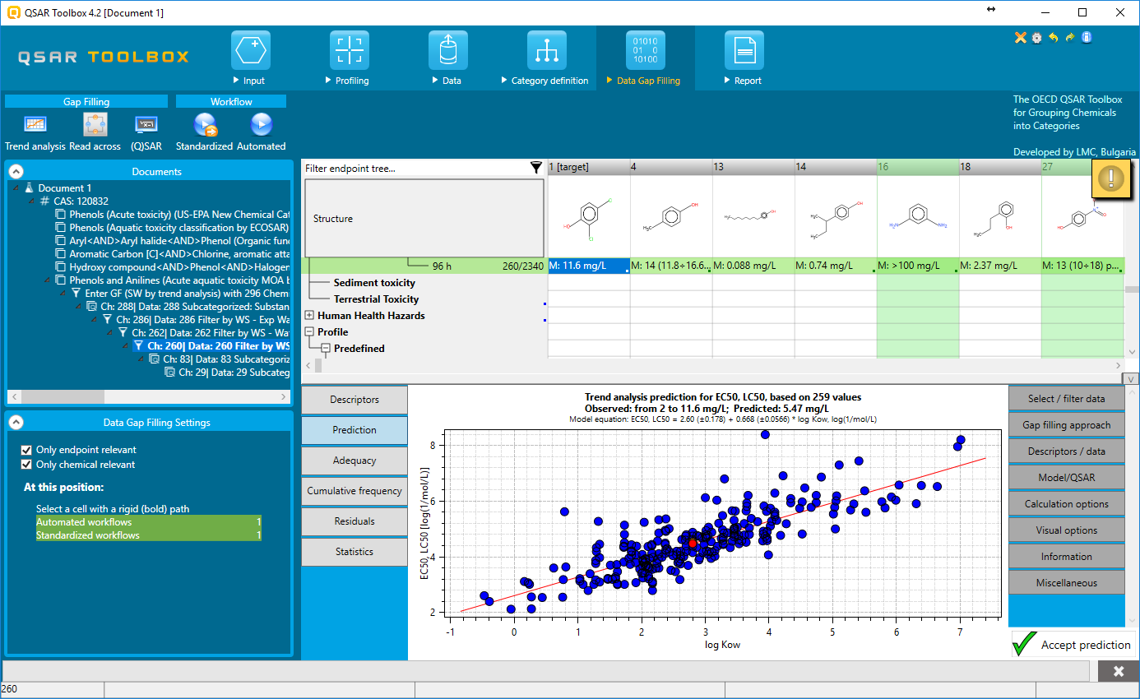
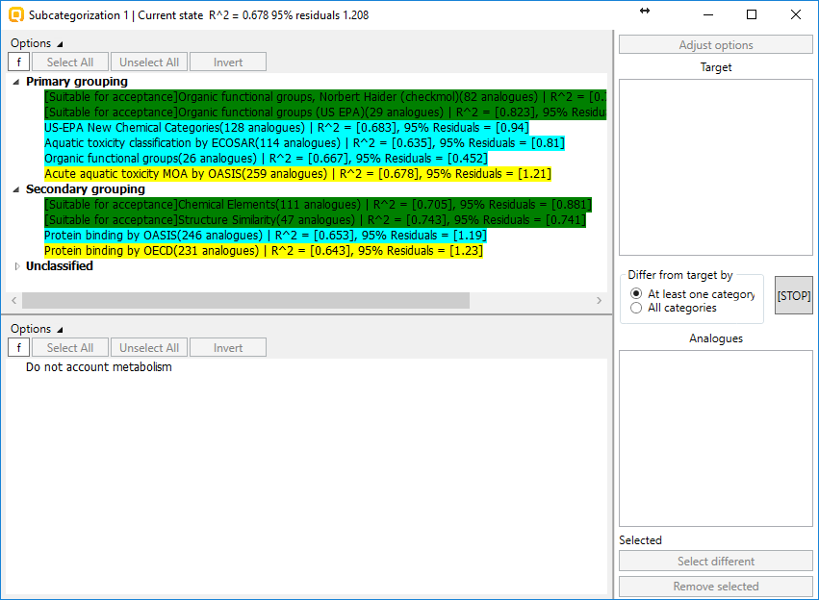
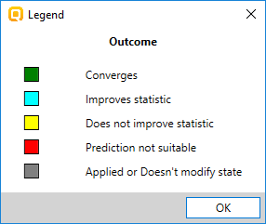
Automated and Standardized workflows in Toolbox v.4.2
SW for Ecotoxicological endpoint - example
Data Gap Filling: Subcategorization dialogue provides the list with relevant profilers highlighted in different color and order by priority factor
Subcategorization ordered by priority factor
Legend of color

Slide 30
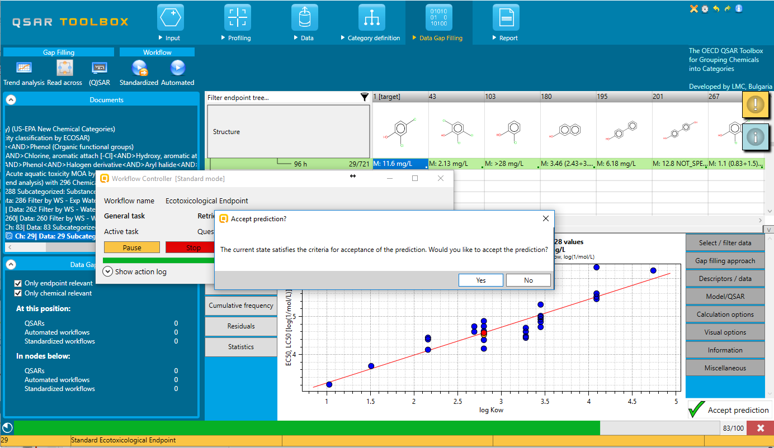
Automated and Standardized workflows in Toolbox v.4.2
SW for Ecotoxicological endpoint - example
Subcategorization: The applied subcategorizations are as follows:
Substance type (mandatory)
Filter by WS (mandatory)
OFG (USEPA)
US-EPA Chemical categories
Note: After each subcategorization the workflow controller wait for activity by the user – “Continue” button needs to be clicked.
Once the prediction satisfy the acceptance criteria a message appears.
Predicted LC50(EC50) for all fish of 2,4-dichlorophenol is 4.38 mg/L (toxic) after application of SW for Ecotox

Slide 31
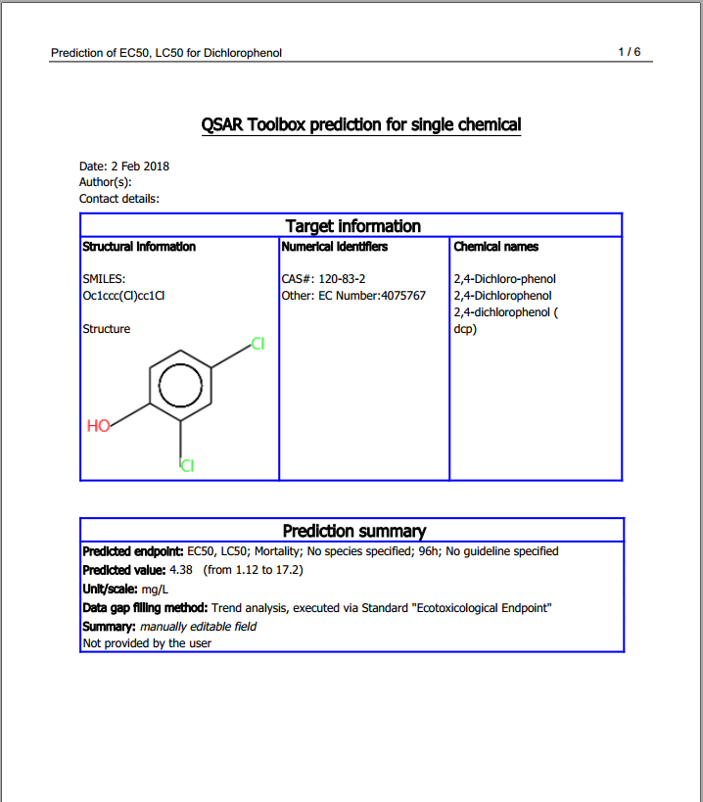
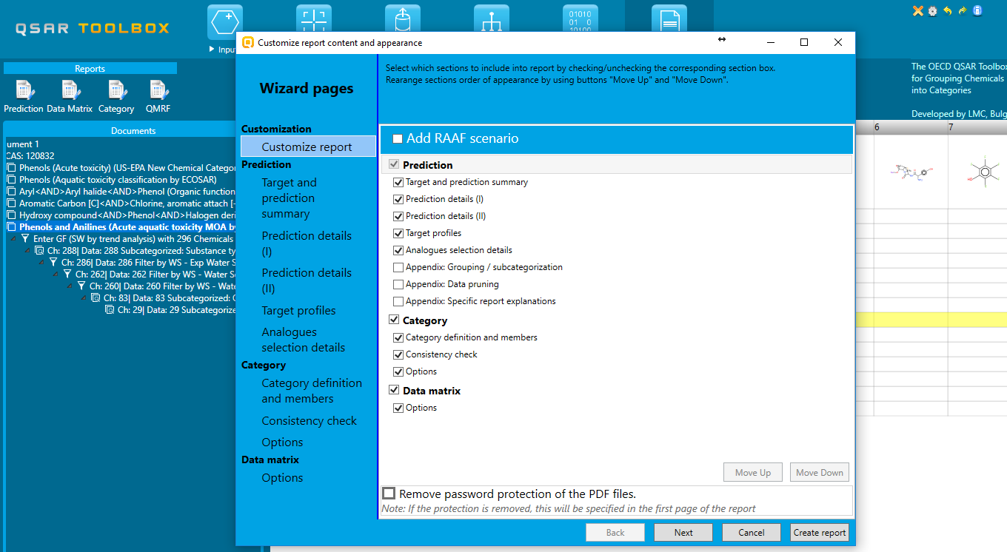
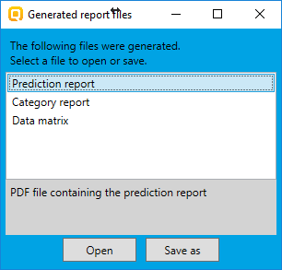
Automated and Standardized workflows in Toolbox v.4.2
SW for Ecotoxicological endpoint - example
Report: the report could be generated once the prediction is obtained

Slide 32
Automated and Standardized workflows in Toolbox v.4.2
AW for Ecotoxicological endpoint - example
Activation: The Automated workflow is activated by clicking on the corresponding button
Automated workflow
List with available workflows

Slide 33
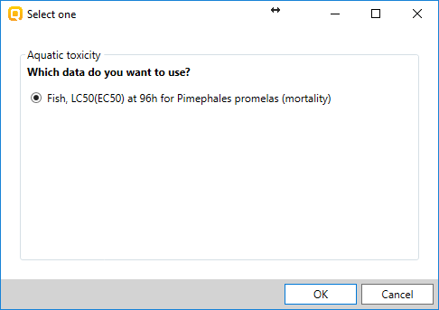
Automated and Standardized workflows in Toolbox v.4.2
AW for Ecotoxicological endpoint - example
Selection of endpoint: The AW for Ecotoxicological endpoint needs the endpoint to be confirmed.
Endpoint: EC50 or LC50 for Pimephales promelas, duration: 96h
Confirmation of endpoint for execution of AW

Slide 34
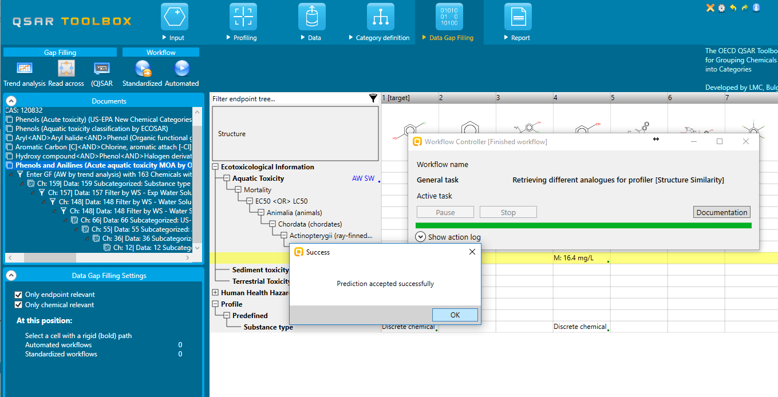
Automated and Standardized workflows in Toolbox v.4.2
AW for Ecotoxicological endpoint - example
All the consecutive steps are applied automatically:
Selection of databases
Selection of primary group
Sequence of subcategorizations
Accept the prediction
The prediction is accepted if answer the criteria of gap filling approach

Slide 35
Outlook
Endpoints
Specificities
Components
Executing module
Algorithm of Ecotoxicological workflow
Predicting Ecotoxicity by using the workflows - examples
Algorithm of Skin sensitization workflow
Predicting Skin sensitization by using the workflows - examples
Notes:
35

Slide 36
Automated and Standardized workflows in Toolbox v.4.2
Algorithm of Skin sensitization workflow
Part 1
Input
Entering target chemical
Profiling
Identification of structural characteristics and mechanism of action
Data
Skin sensitization data
1
2
Category definition
Is protein binding alert for skin sensitization identified in the target?
Is protein binding alert for skin sensitization identified after AU simulation?
N
Is protein binding alert for skin sensitization identified after SM simulation?
N
N
Y
Y
Y
Define category by the protein binding alert identified in the target
Define category by the protein binding alert(s) identified in the package target + generated AU products
Define category by the protein binding alert(s) identified in the package target + generated SM products
Data gap filling
Subcategorization:
Substance type
PBA for SS
Subcategorization by:
Substance type
PBA for SS
PBA for SS +AU
PBA for SS +SM
Structural similarity (threshold 50 %)
Prediction is based on closest analogues
Reporting
Report of prediction

Slide 37
Automated and Standardized workflows in Toolbox v.4.2
Algorithm of Skin sensitization workflow
Part 2
Input
Entering target chemical
Profiling
Identification of structural characteristics and mechanism of action
Data
PBA for SS is found
Skin sensitization data
PBA for SS is not found
Category definition
1
N
2
Define category by most populated category based on structurally related profiling method s, e.g. OFG, OFG USEPA, etc.
Subcategorization by:
Substance type
PBA for SS
PBA for SS +AU
PBA for SS +SM
Protein binding potency
Keratinocyte gene expression alerts
OFG, OFG US EPA, OFG N. Haider
Structural similarity (threshold 50 %)
Data gap filling
Prediction is based on closest analogues
Reporting
Report of prediction

Slide 38
Automated and Standardized workflows in Toolbox v.4.2
Algorithm of Skin sensitization workflow
Databases
Skin sensitization
Skin sensitization ECETOC
REACH Skin sensitisation database (normalized)
SS predictions are based on LLNA and GPMT exp. data.
LLNA – EC3, %
GPMT - Strong, Moderate, Weak and Non sensitizer
The dichotomous scale converting LLNA and GPMT potency categories into Positive and Negative SS is preferred when select to use LLNA and GPMT data

Slide 39
Automated and Standardized workflows in Toolbox v.4.2
Algorithm of Skin sensitization workflow
Profilers for primary grouping
US EPA New Chemical Categories
Aquatic toxicity classification by ECOSAR
Protein binding alerts for Skin sensitization effect
Organic Functional Groups
Organic Functional Groups by US EPA
Organic Functional Groups by N. Haider
Abiotic and biotic activation of chemical is accounted by application of respective Autoxidation (AU) and Skin metabolism (SM) simulators

Slide 40
Automated and Standardized workflows in Toolbox v.4.2
Algorithm of Skin sensitization workflow
Category definition
If protein binding alert for skin sensitization (PBA for SS) is identified in the target structure then the primary category is based on this alert
If PBA for SS is identified after AU or SM simulation then the primary category is defined accounting the metabolic simulation
If more than one PBA for SS are identified in the parent structure or in the generated metabolites, then:
the category is defined based on all available PBA as presented in the target structure
In case no analogues found, the selection of alert is based on the criteria for reliability of alerts, i.e. most reliable alert is selected (see next slide)
If No PBA for SS is identified in the parent structure and in the generated metabolites, then the primary category is defined on global molecular features by using:
Organic Functional Groups (OFG), OFG USEPA, OFG N. Haider
Acute aquatic classification by ECOSAR
US-EPA New Chemical categories
In this case, the most appropriate category is the collection of a broader group of analogues.

Slide 41
Automated and Standardized workflows in Toolbox v.4.2
Algorithm of Skin sensitization workflow
Data gap filling
Prediction is based on up to five closest analogues with respect to logKow
Read across is applied as default gap filling approach
Specific subcategorizations are applied depending on the profiling result and subsequent primary group formation (see next slide for more information)
If no analogues with data are found, then no prediction is obtained after application of the workflows

Slide 42
Outlook
Endpoints
Specificities
Components
Executing module
Algorithm of Ecotoxicological workflow
Predicting Ecotoxicity by using the workflows - examples
Algorithm of Skin sensitization workflow
Predicting Skin sensitization by using the workflows - examples
Notes:
42

Slide 43
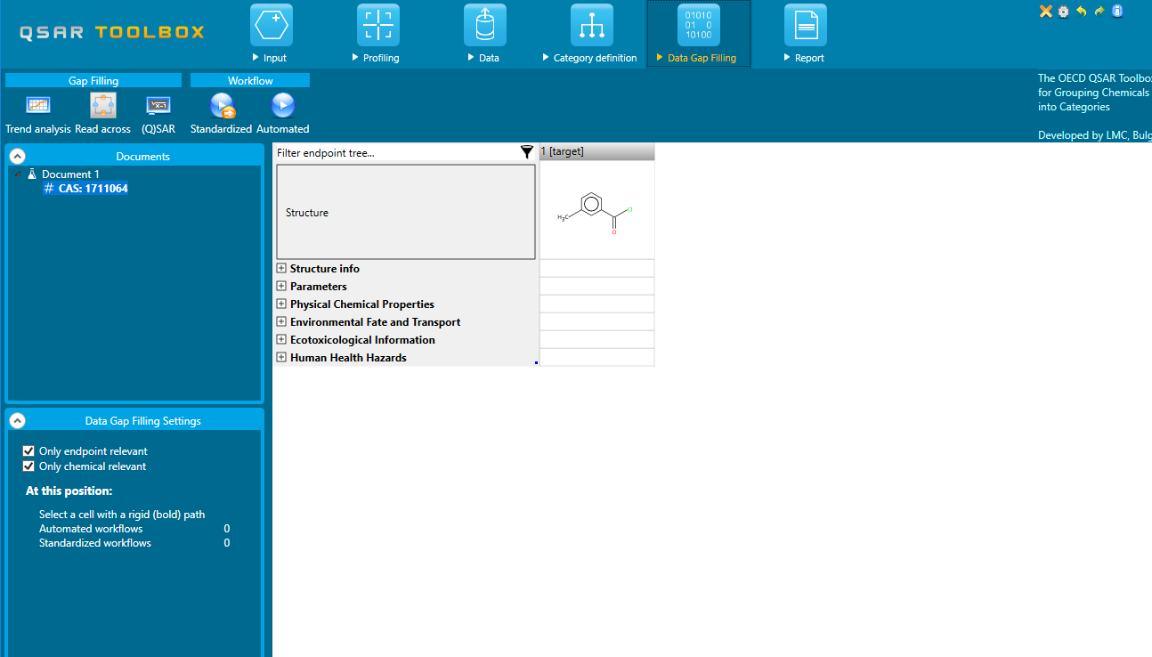
Automated and Standardized workflows in Toolbox v.4.2
SW for Skin sensitization - examples
Location: The AWs and SWs are part of the DGF
Automated workflow
Standardized workflow

Slide 44
Automated and Standardized workflows in Toolbox v.4.2
SW for Skin sensitization - examples
Activation: The SW is activated by clicking on the corresponding button
CAS 1711-06-4
Example 1: Target chemical has protein binding alert
Standardized workflow

Slide 45
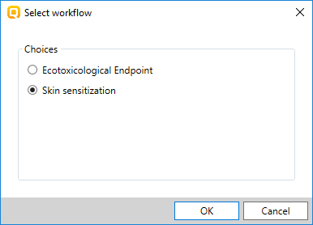
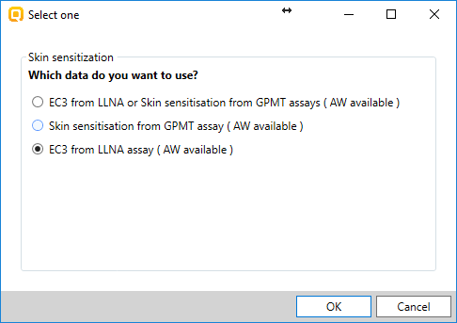
Automated and Standardized workflows in Toolbox v.4.2
SW for Skin sensitization - examples
Selection of endpoint: Three options for data usage are provided: EC3, GPMT and EC3/GPMT
Example 1: Target chemical has protein binding alert
List with implemented workflows: Select “Skin sensitization”
List with endpoints and experimental data for Skin sensitization: Select EC3 from LLNA

Slide 46
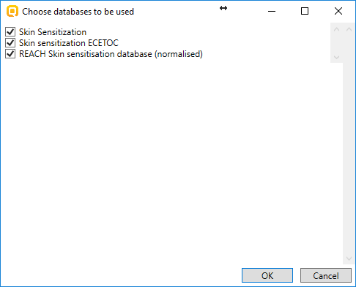
Automated and Standardized workflows in Toolbox v.4.2
SW for Skin sensitization - examples
Selection of databases: Three databases are available
Example 1: Target chemical has protein binding alert
Workflow controller is activated
List with databases

Slide 47
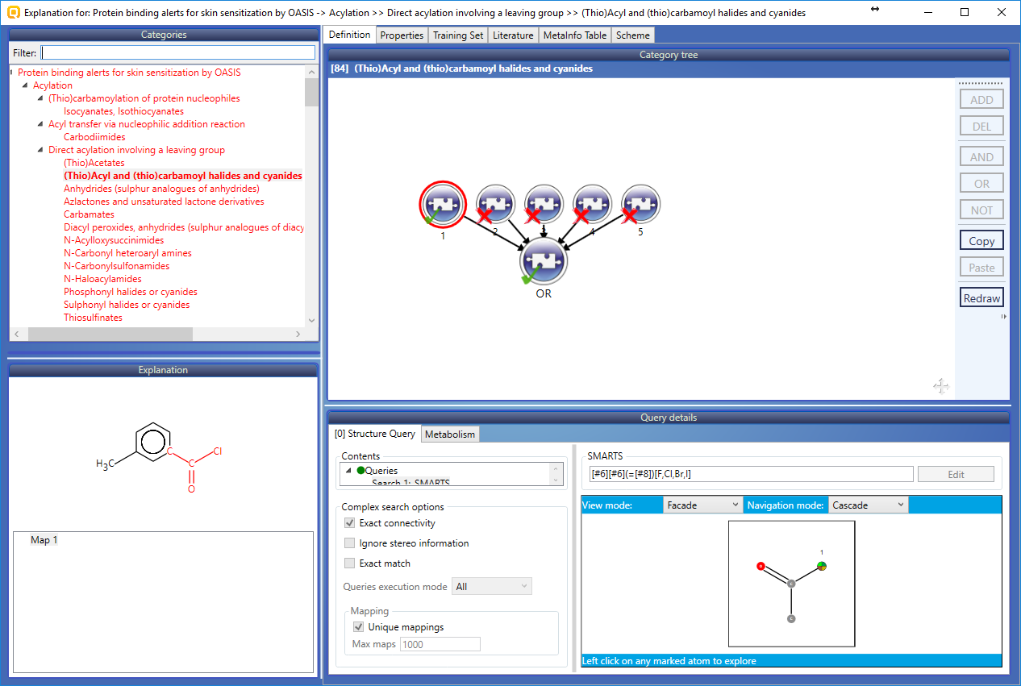
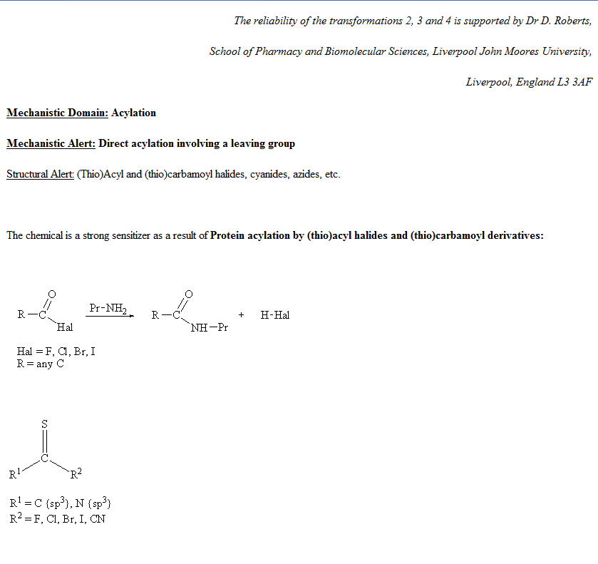
Automated and Standardized workflows in Toolbox v.4.2
SW for Skin sensitization - examples
Category definition: Primary group is defined based on the alert found in the target
Example 1: Target chemical has protein binding alert
1

Slide 48
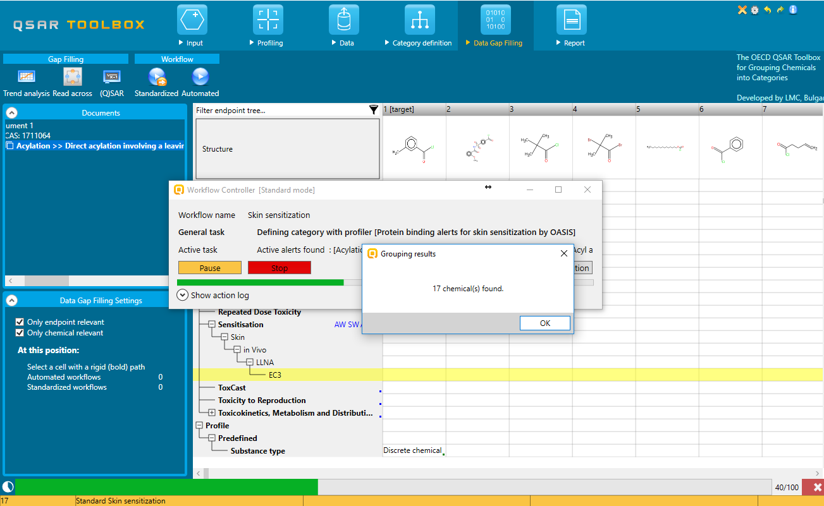
Automated and Standardized workflows in Toolbox v.4.2
SW for Skin sensitization - examples
Category definition: Primary group is defined based on the alert found
Example 1: Target chemical has protein binding alert
17 chemicals are found based on the primary group

Slide 49
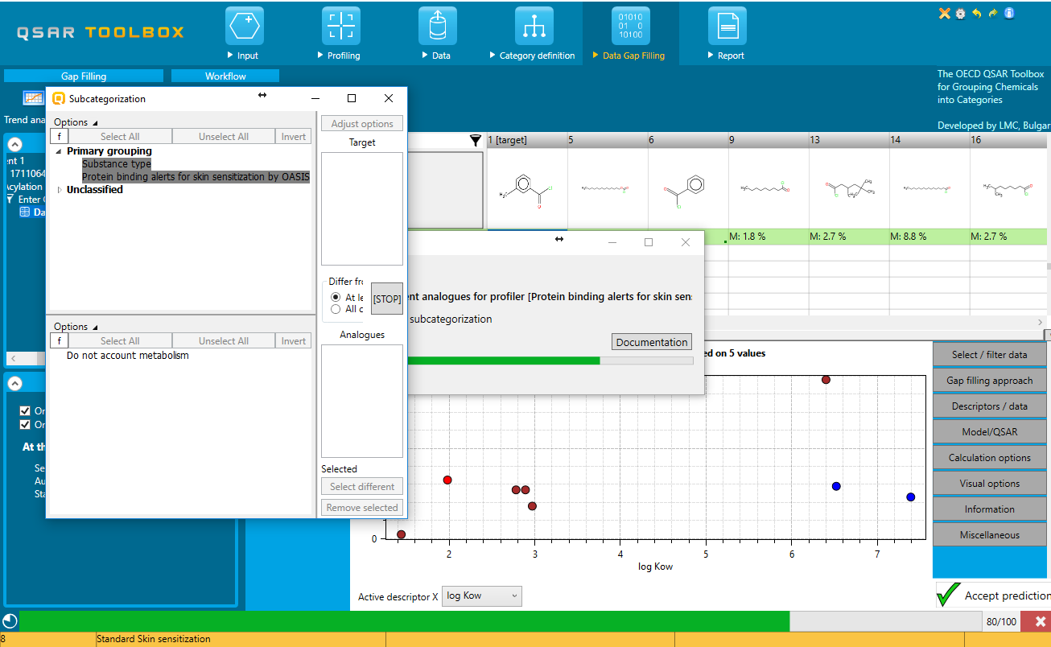
Automated and Standardized workflows in Toolbox v.4.2
SW for Skin sensitization - examples
Data Gap Filling: Relevant to the workflow profilers are provided and colored
Example 1: Target chemical has protein binding alert
Relevant to the workflow profilers are listed here and ordered in a way they are executed in AW
Legend of different color meaning

Slide 50
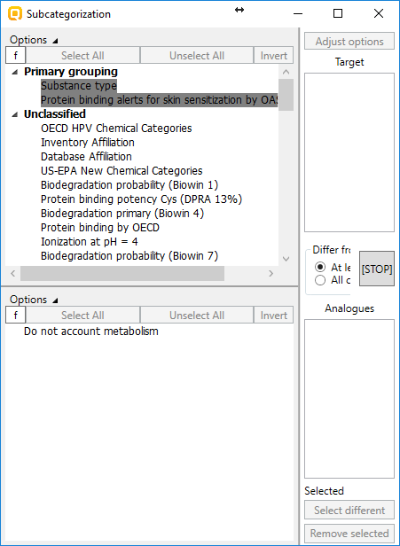
Automated and Standardized workflows in Toolbox v.4.2
SW for Skin sensitization - examples
Data Gap Filling: Relevant to the workflow profilers are provided and colored
Example 1: Target chemical has protein binding alert
The rest of profilers are also here and can be used to subcategorize

Slide 51
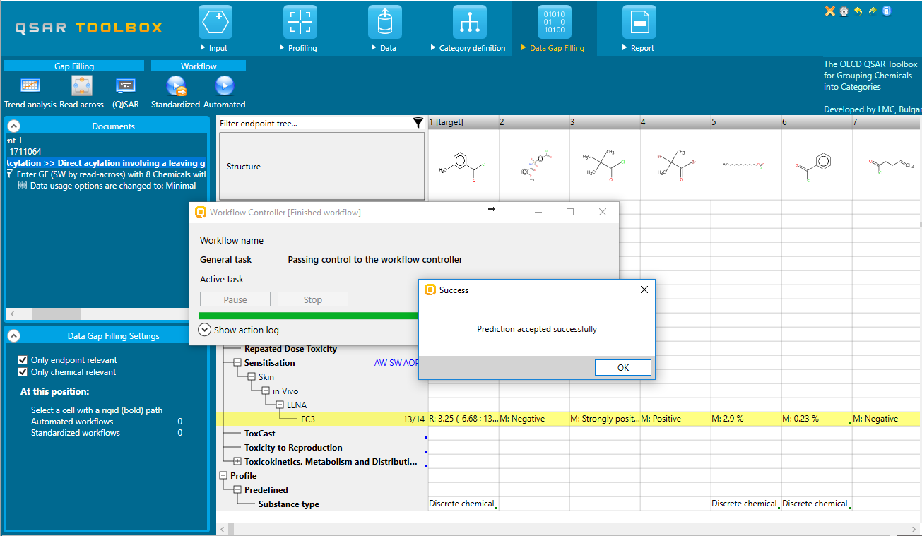
Automated and Standardized workflows in Toolbox v.4.2
SW for Skin sensitization - examples
Data Gap Filling: Relevant to the workflow profilers are provided and colored
Example 1: Target chemical has protein binding alert

Slide 52
Automated and Standardized workflows in Toolbox v.4.2
SW for Skin sensitization - examples
Activation: The SW is activated by clicking on the corresponding button
CAS 56-18-8
Example 2: Target chemical is activated metabolically
Standardized workflow

Slide 53
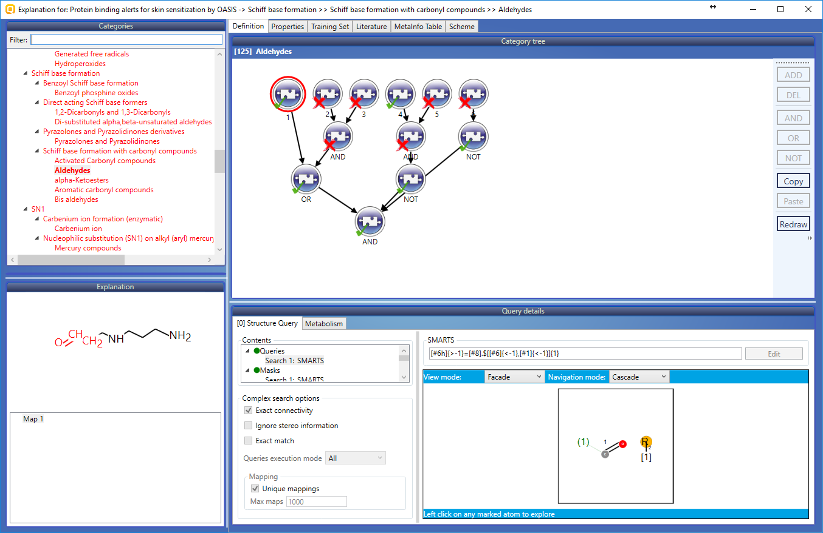
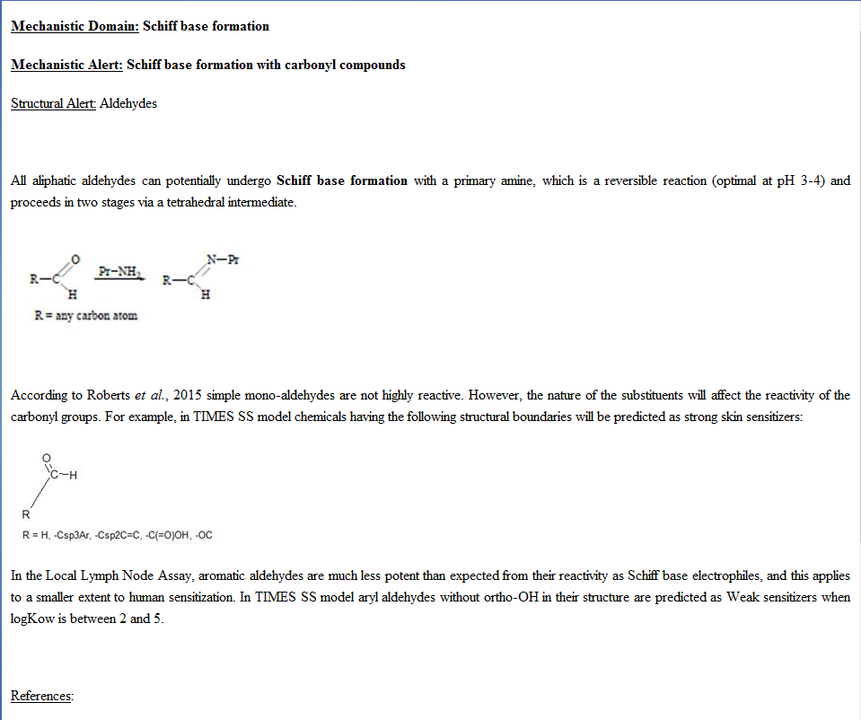
Automated and Standardized workflows in Toolbox v.4.2
SW for Skin sensitization - examples
Illustration of the active metabolite obtained after skin metabolism simulation
Example 2: Target chemical is activated metabolically
1

Slide 54
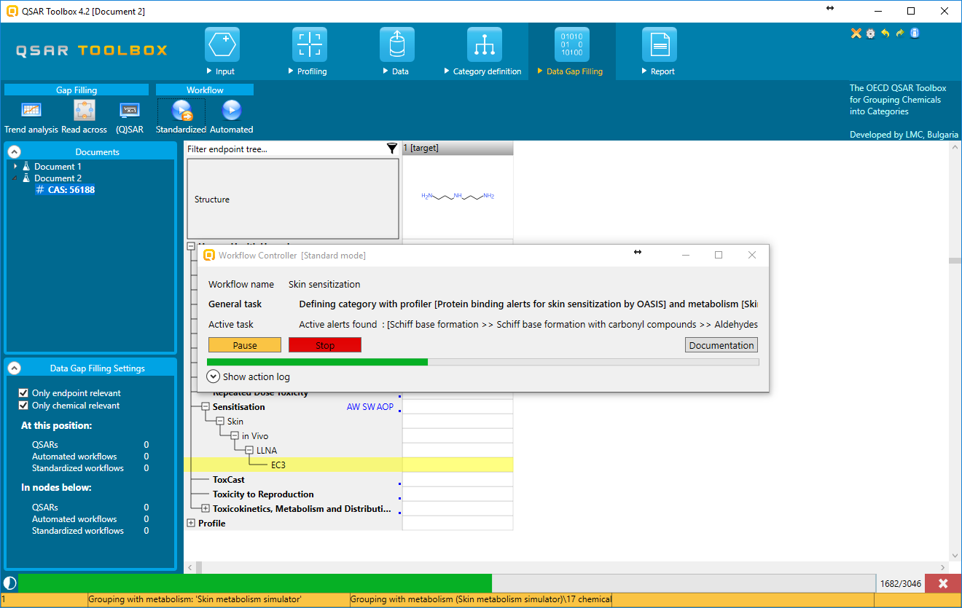
Automated and Standardized workflows in Toolbox v.4.2
SW for Skin sensitization - examples
Category definition: Primary group is defined accounting skin metabolism activation
Example 2: Target chemical is activated metabolically
Status bar showing that current grouping is applied with metabolism

Slide 55
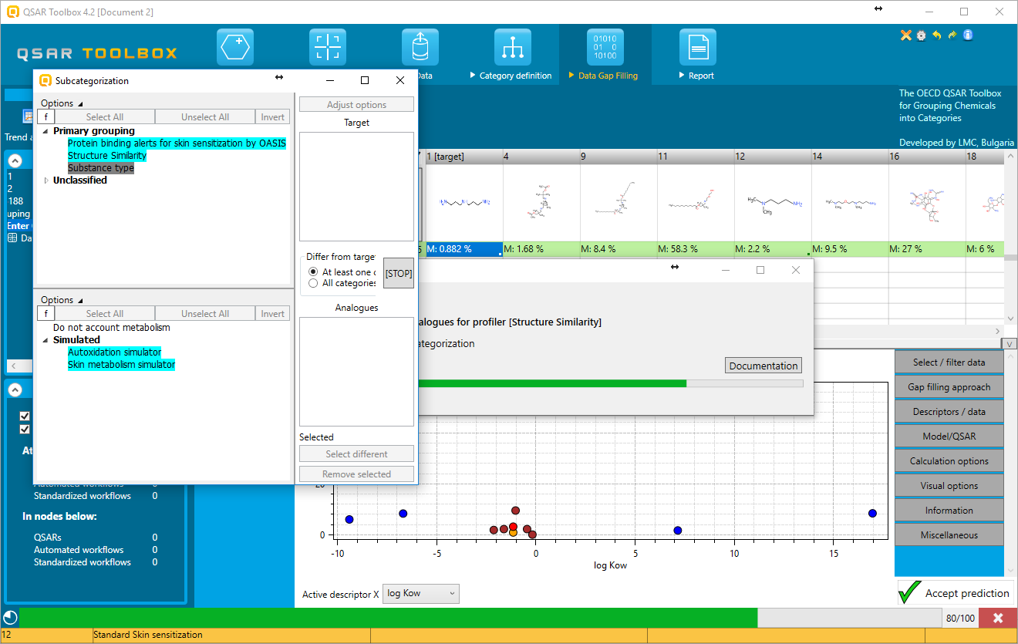
Automated and Standardized workflows in Toolbox v.4.2
SW for Skin sensitization - examples
Data Gap Filling: Relevant to the workflow profilers are provided and colored
Example 2: Target chemical is activated metabolically
Relevant to the workflow profilers and simulators are listed here and ordered in a way they are executed in the AW
Legend of different color meaning

Slide 56
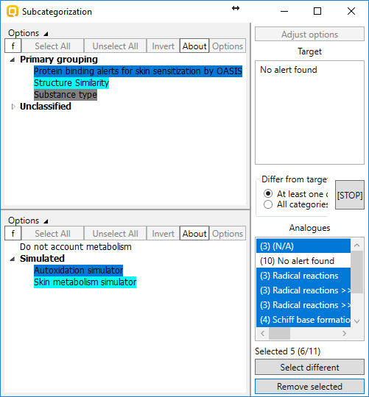
Automated and Standardized workflows in Toolbox v.4.2
SW for Skin sensitization - examples
Data Gap Filling: Relevant to the workflow profilers are provided and colored
Example 2: Target chemical is activated metabolically
Apply the following subcategorizations:
Protein binding alerts for skin sensitization by OASIS + Autoxidation simulator;
Structure similarity – select all having at least 50% similarity with respect tot the target
After each subcategorization the Subcategorization dialogue is closed (see next slide)

Slide 57
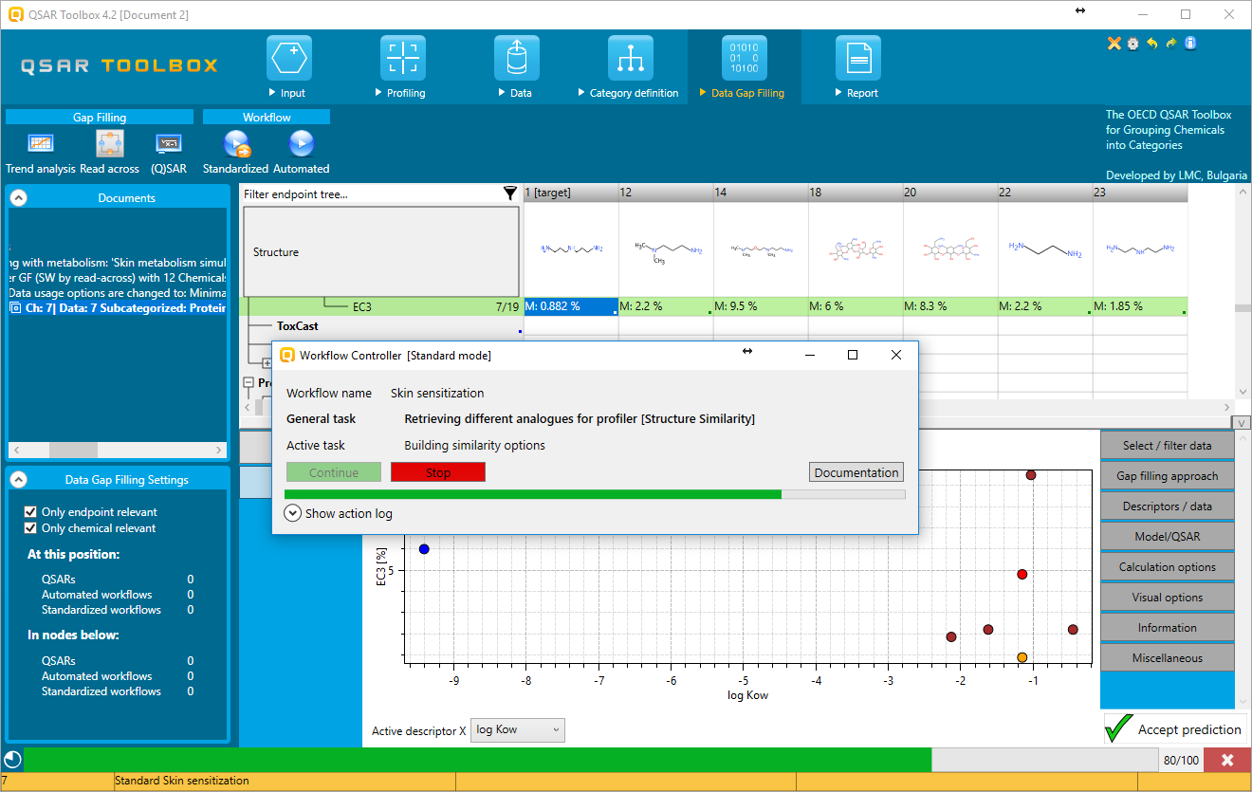
Automated and Standardized workflows in Toolbox v.4.2
SW for Skin sensitization - examples
Data Gap Filling: Relevant to the workflow profilers are provided and colored
Example 2: Target chemical is activated metabolically
Continue button should be pressed in order to open the subcategorization

Slide 58
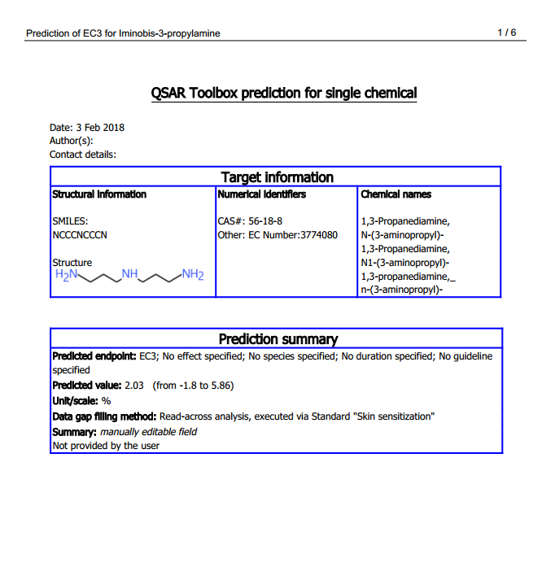
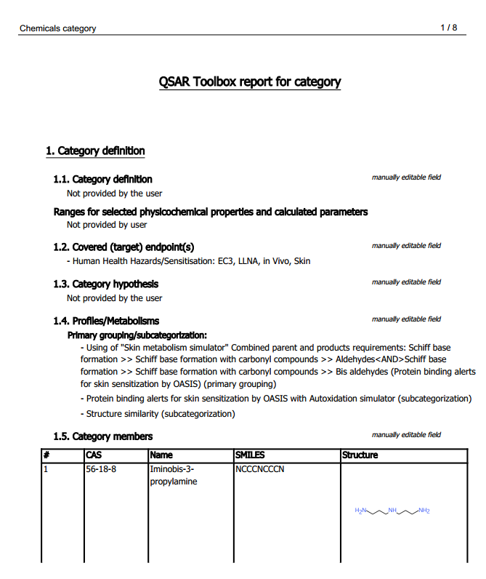
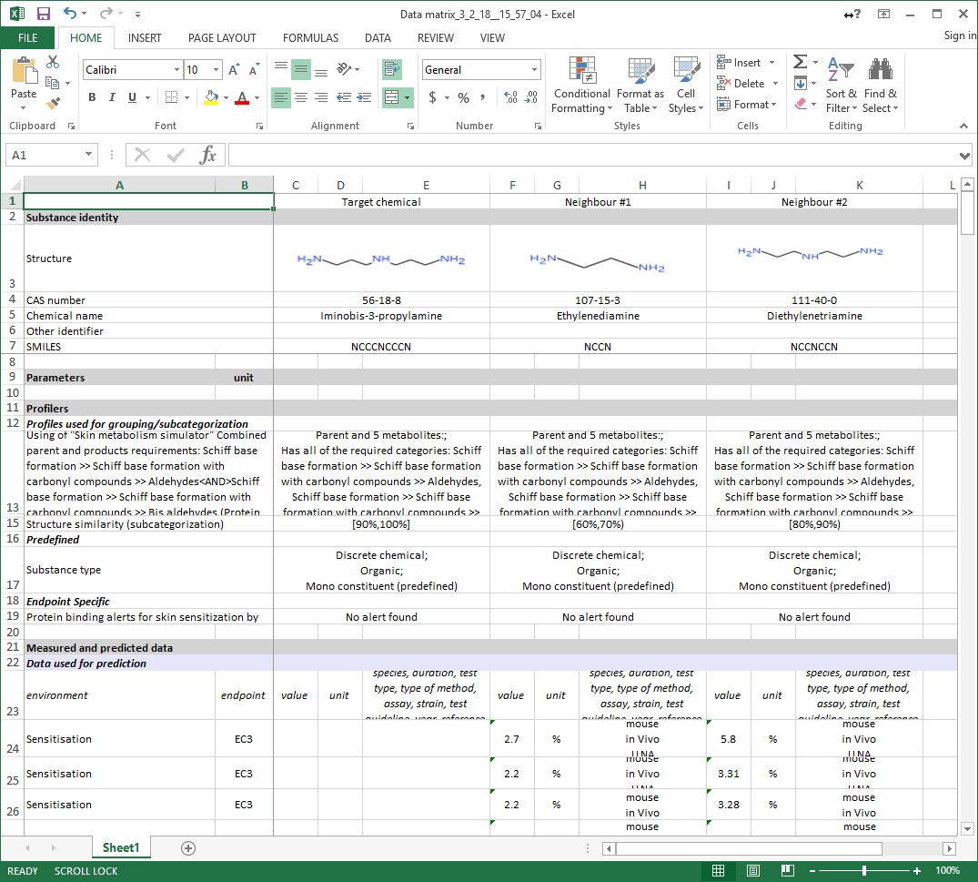
Automated and Standardized workflows in Toolbox v.4.2
SW for Skin sensitization - examples
Report
Report is not part of the workflows
Information specifying that the prediction is produced by AW or SWs is available in the report
Prediction report
Category report
Reporting of additional information (from data matrix) is provided in excel

Slide 59
Automated and Standardized workflows in Toolbox v.4.2
AW for Skin sensitization - examples
Activation: The Automated workflow is activated by clicking on the corresponding button
CAS 56-18-8
Automated workflow

Slide 60
Automated and Standardized workflows in Toolbox v.4.2
AW for Skin sensitization - examples
Selection of endpoint: Three options for data usage are provided: EC3, GPMT and EC3/GPMT
Automated workflow
List with endpoints and experimental data for Skin sensitization: Select EC3 from LLNA
List with available workflows

Slide 61
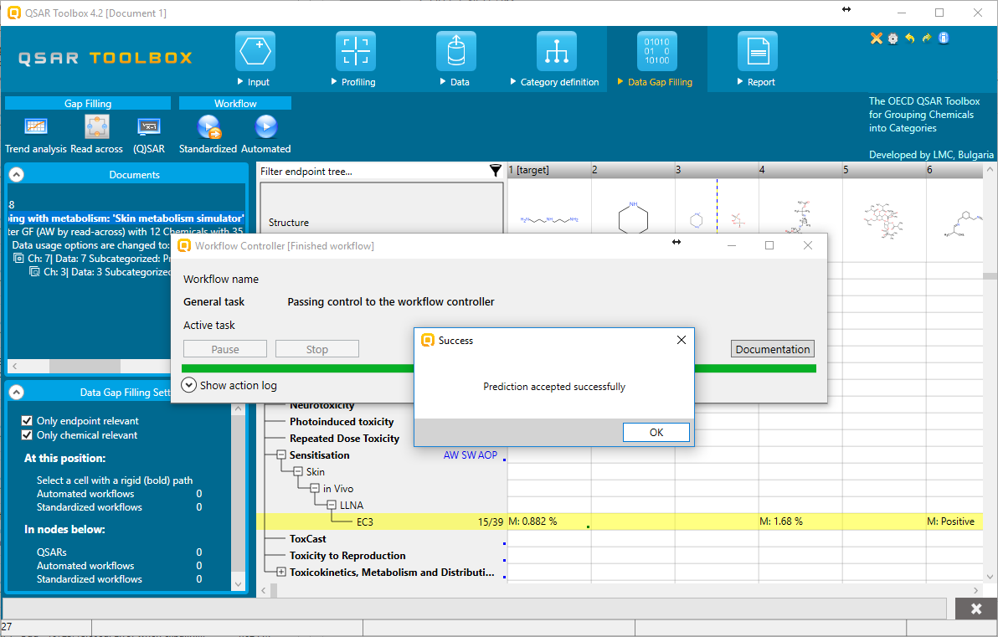
Automated and Standardized workflows in Toolbox v.4.2
AW for Skin sensitization - examples
All the consecutive steps are applied automatically:
Selection of databases
Selection of primary group
Sequence of subcategorizations
Accept the prediction
The prediction is accepted

